Slide 1
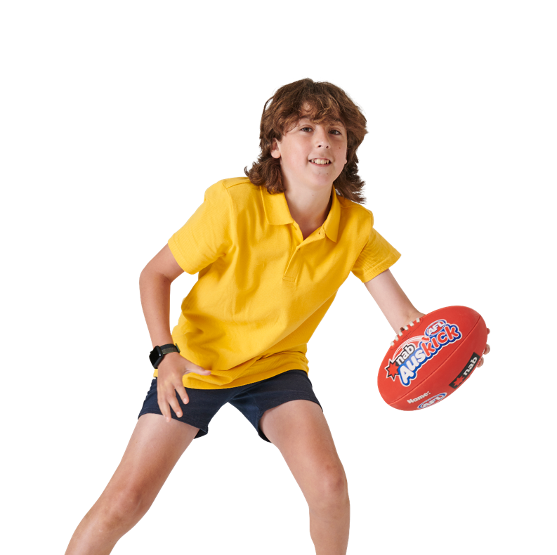





INTERACTIVE RESOURCE PACK
FOUNDATION - YEAR 2

Slide 2


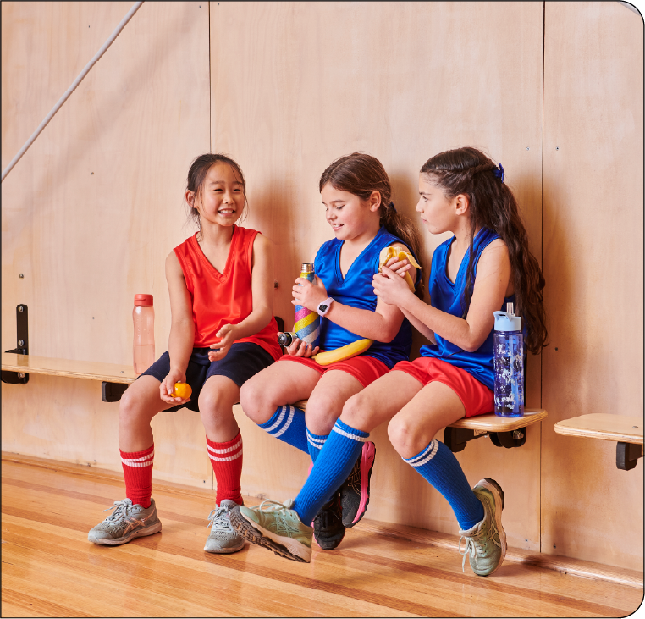
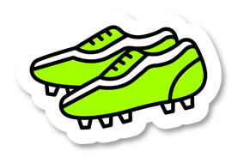
CONTENTS
Lesson 1:
The five food groups
Lesson 2:
Healthy food choices
Lesson 3:
Hydration and sustainability
Lesson 4:
Let’s create a garden
Lesson 5:
Snack attack
CONTENTS
Lesson 1:
The five food groups
Lesson 2:
Healthy food choices
Lesson 3:
Hydration and sustainability
Lesson 4:
Let’s create a garden
Lesson 5:
Snack attack

Slide 3

AUSTRALIAN RULES FOOTBALL BALL SKILLS
Angry Ogre (similar to What’s the Time Mr Wolf) | 1 ball per student Students line up along the playing area, directly opposite a ball on the far side of the playing area. A student or the teacher is the ‘Angry Ogre’ and must stand in front of the balls with their back to the students. Students sneak up behind the Angry Ogre to steal a ball. When the Angry Ogre turns around, students must freeze! If the Angry Ogre spots someone moving, they must go back to the starting line. When a student grabs a ball, they shout ‘Angry Ogre!’ Students run to grab a ball and race back to the starting line while Angry Ogre aims to chase and tag as many students as possible. If anyone makes it back without being tagged by the Angry Ogre, they win!
Handball Relay | 1 ball per group of 4-6 students Place cones in a line on the ground with students standing behind a cone. Have a student stand a few metres away facing the group with the football on the ground halfway between them. Students race forward, pick up the ball and handball it to the student. They then run around the student, receive the ball back and return it to the middle as they make their way back to their starting cone. Do this a few times! Next the students could handball the football back and forth. Modified version Ball starts on the ground midway between the facing student and the group First student runs forward Picks up the ball Handballs to the facing student Receives the ball back Returns the ball to the middle Returns to the original cone Repeat

Slide 4

AUSTRALIAN RULES FOOTBALL BALL SKILLS
Mad Marks | 1 football per pair Each student lines up opposite each other about one metre apart. For chest marks: One student gently throws the ball to their partner so their arms can hug the ball into their chest. For overhead marks: Have one student take a few steps back and hold the ball at shoulder height. Their partner runs forward and grabs it! For a ‘spectacular’ (speccy) mark: Have one partner hold the ball out to the side and higher than their shoulders. Have the other student run towards the ball and jump to try to grab it with their knees in the air (like a speccy)! After a few goes, have one student toss up the football (rather than holding it) for their partner to catch.
Here, There, Everywhere | Students run in certain directions and bounce the football depending on the word you shout: ‘Here’ means students run towards you. ‘There’ means students run in the direction you’re pointing. ‘Everywhere’ means students can move wherever they want inside the playing area. ‘Nowhere’ means students have to stand still on the spot and bounce the football. Modified version Reduce the number of directions e.g. ‘here’ ‘there’ ‘stop (instead of nowhere)’
Kick the Stick | 1 ball and cone per student Use the cones to make a circle, with the goal post target in the middle. Students are to have one ball and stand next to a cone. On ‘go’ students kick their footy and aim for the stick! Anyone who hits the stick gets a point.

Slide 5


AUSTRALIAN RULES FOOTBALL BALL SKILLS
Coast to Coast | Use cones to create two different coloured lines leading up to the goal posts. Each line is a team and each student must stand by their own cone. The objective for each team is to get their ball from one end of the line to the other end (‘Coast to Coast’). To do this, students pass the ball to their teammates by using different skills. For example, the first student may roll the ball to the next student, then the next may handball. The last student has a kick for a goal! The student gets the ball back and races to the start of the line with team mates moving down one spot to the next cone. Modified version Students are only given one ball skill for the whole line to complete at a time. Once it reaches the last student in the line and they have completed the skill, the students then pass the ball back from that direction using a new skill.

Slide 6
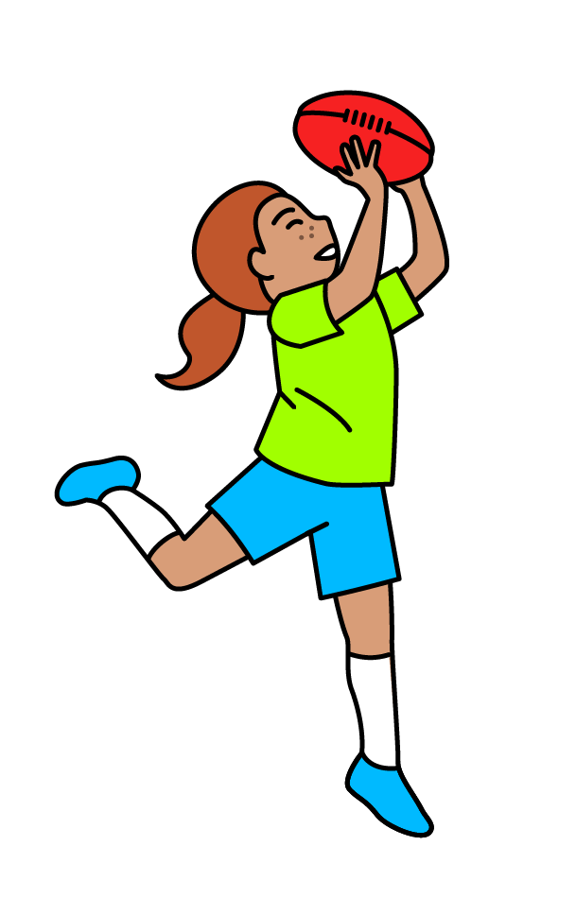

CHK VIDEOS : THE FIVE FOOD GROUPS

Slide 7
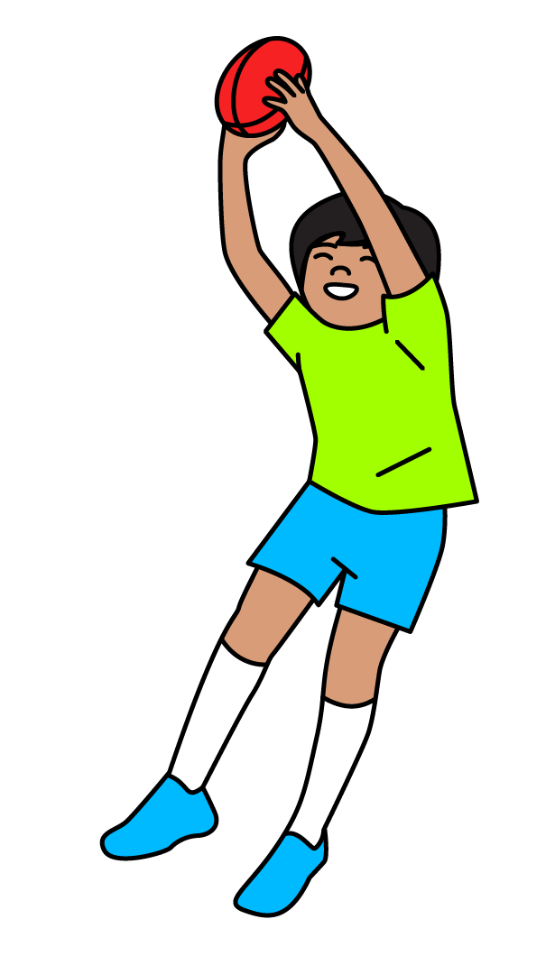
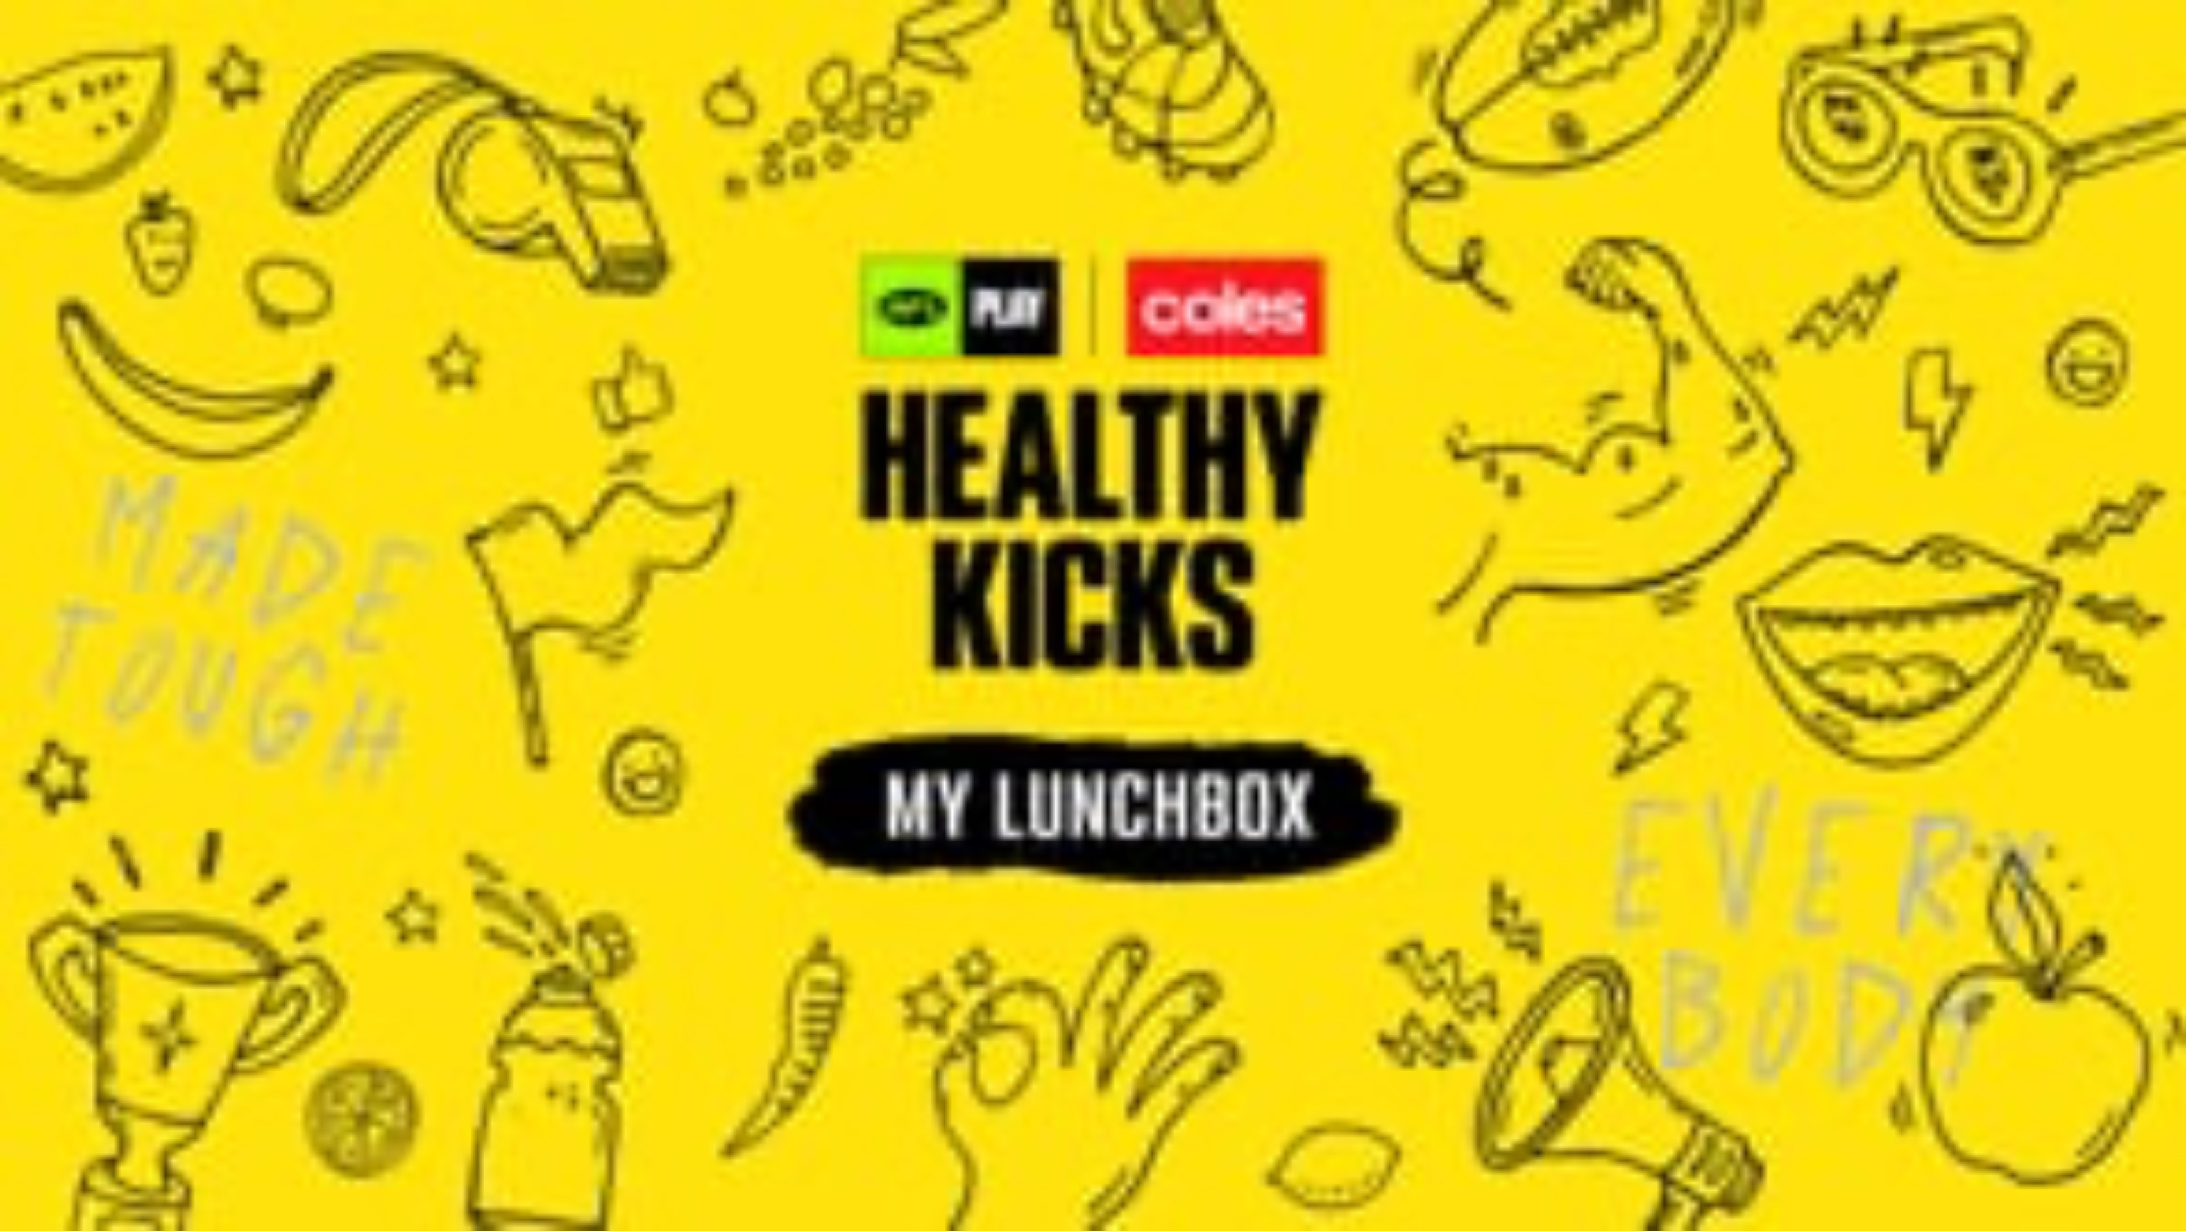
CHK VIDEOS : MY LUNCHBOX

Slide 8

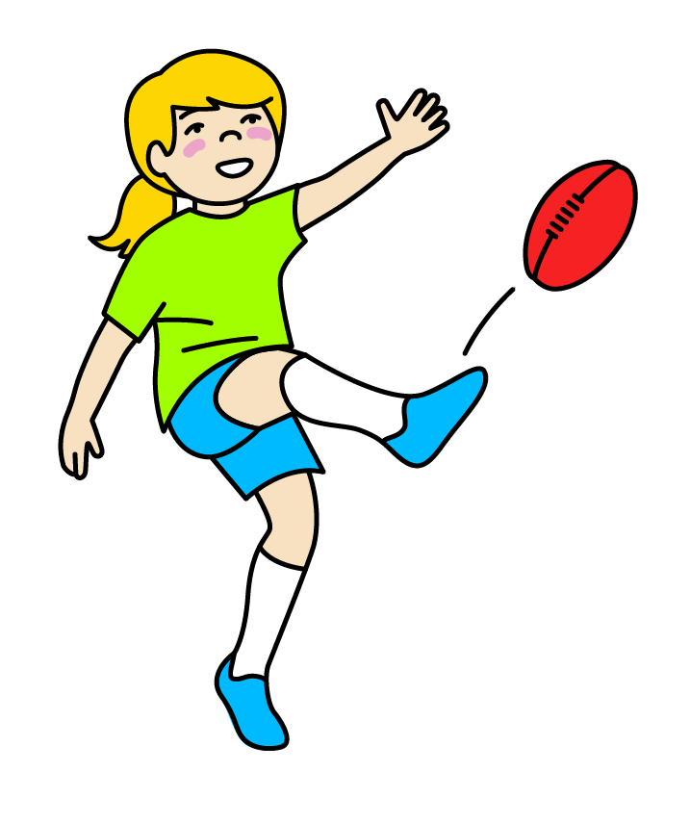
CHK VIDEOS : FUELING OUR BODIES

Slide 9

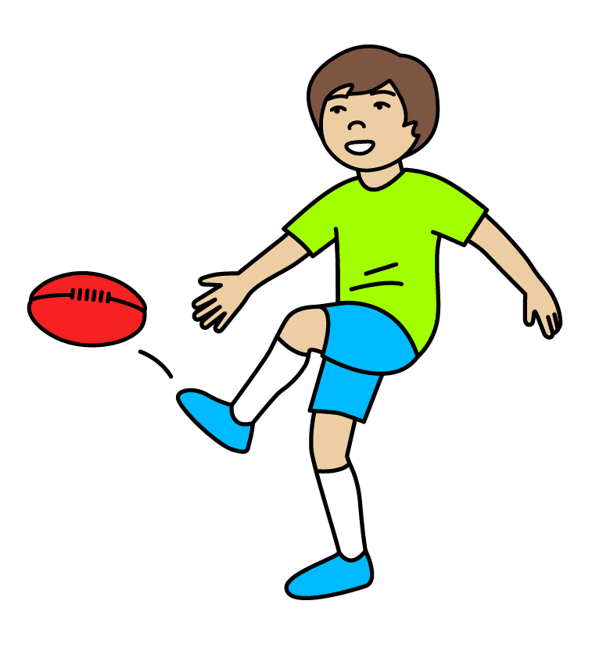
CHK VIDEOS : FOOD AND CULTURE

Slide 10

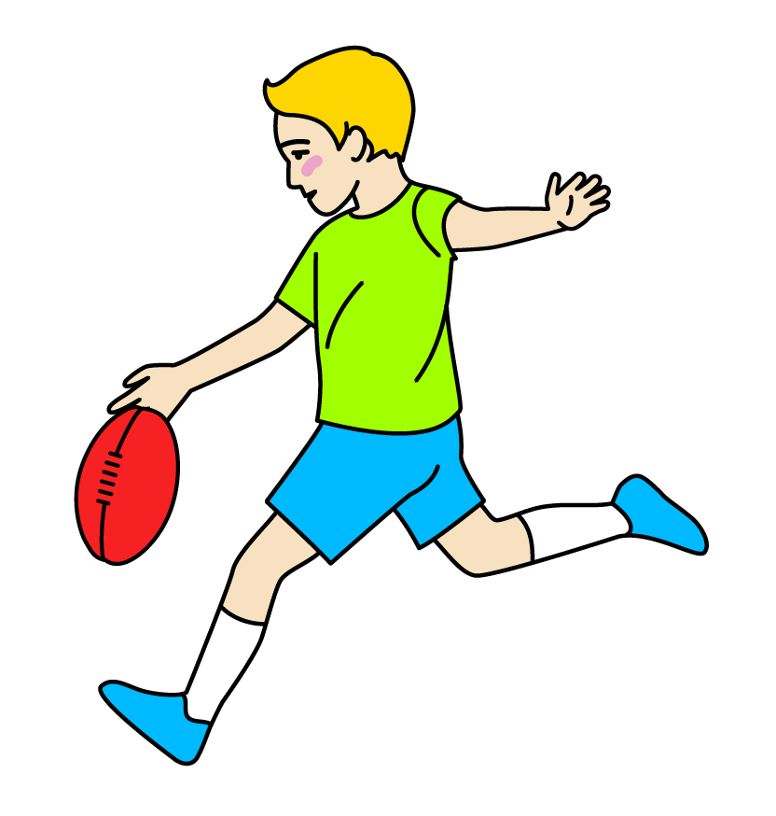
CHK VIDEOS : HYDRATION

Slide 11
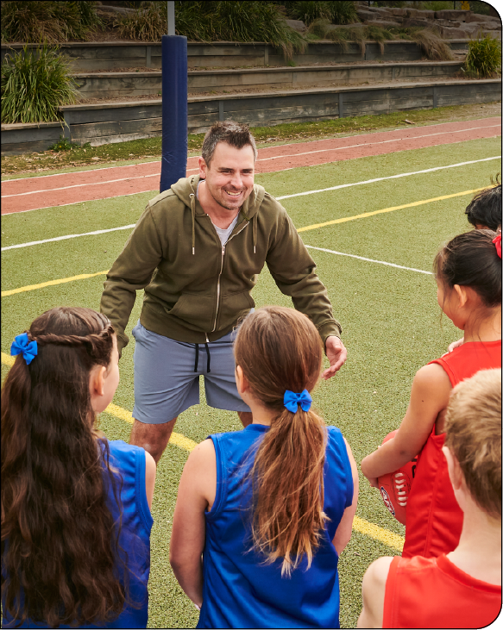

LESSON 1: THE FIVE HEALTHY
FOOD GROUPS
Learning intention
In this lesson, we will participate in mobility and stretching exercises, identify food groups and their roles in healthy eating, and learn the steps involved in the design process.
Success criteria
I will know I am successful when I can:
Participate in mobility and stretching exercises
Identify why it is important to be active
Sort foods into their different food groups

Slide 12
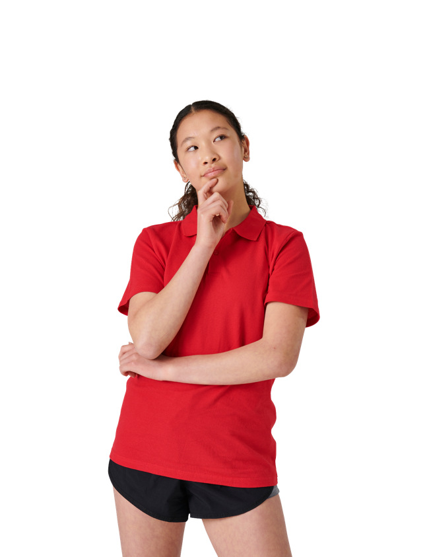

GUIDING QUESTIONS
GUIDING QUESTIONS
How do you feel when you are playing
footy or doing exercise?
How do you feel when you are playing
footy or doing exercise?
Why is healthy eating important?
Why is healthy eating important?

Slide 13
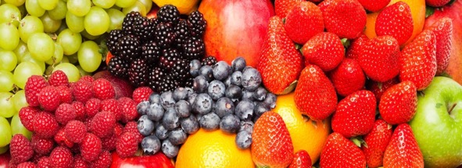
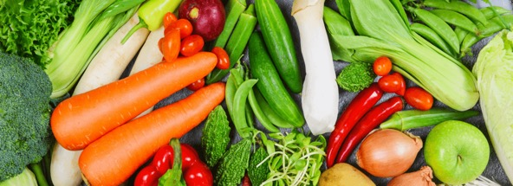
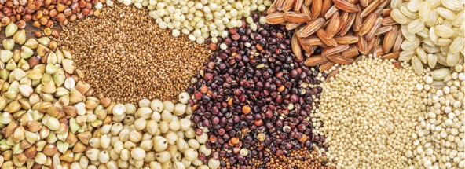
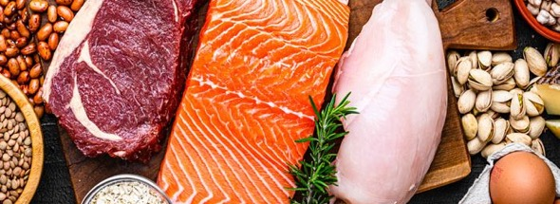
VOCABULARY
FRUITS
VEGETABLES
A sweet and colourful food that grows on trees or plants. They help you stay healthy and gives you energy.
Examples: apples, bananas, oranges, strawberries
Healthy plant foods that we can eat raw or cooked. They help your body grow strong.
Examples: carrots, broccoli, spinach, tomatoes
FRUITS
VEGETABLES
GRAINS
PROTEINS
Small seeds from plants that we can eat. They give your body energy and help you feel full and strong.
Examples: rice, wheat, oats, corn
Foods that help build and repair your body. They help your muscles grow and are important for staying healthy.
Examples: chicken, fish, eggs, beans
GRAINS
PROTEINS

Slide 14
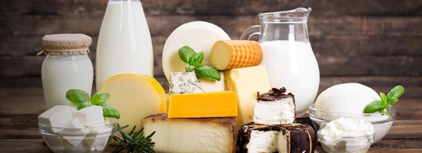
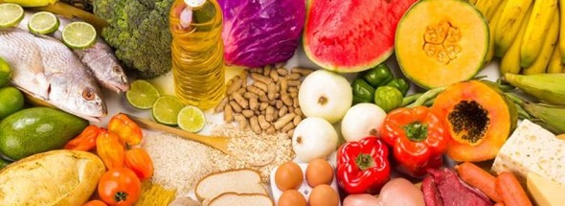
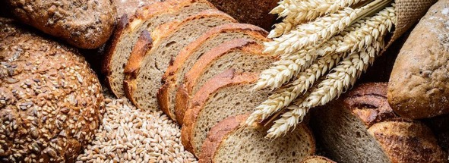
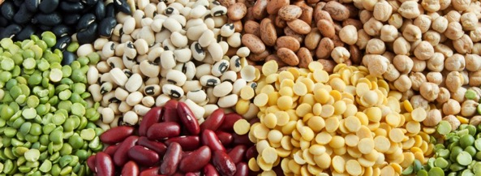
VOCABULARY
DAIRY
BALANCED DIET
DAIRY
To eat different types of healthy foods every day from all of the food groups. It keeps you strong and healthy and helps your body work well.
Foods made from milk that help you grow, and make your bones and teeth strong and healthy.
Examples: milk, cheese, yoghurt
BALANCED DIET
CARBOHYDRATES
LEGUMES
Foods that give your body fuel and quick energy. They help you run and play.
Examples: bread, pasta, potatoes
CARBOHYDRATES
LEGUMES
Plant foods that grow in pods. They are high in protein and fibre and help keep your body healthy.
Examples: beans, lentils, peas
Can you think of any other words that might be important?

Slide 15

KWL
Why do we need to play, move and eat healthy foods to help our body feel strong and happy?
K - What I know
W - What I want to know
L - What I learnt

Slide 16
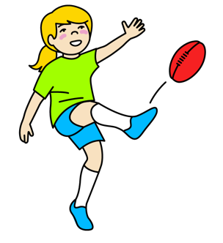
PRE QUIZ
How does physical activity make you feel and why is it important?
How does physical activity make you feel and why is it important?
4. How does being active help us at school or home?
A) Happy
B) Tired
C) Excited
D) All of the above
A) It makes us feel good
B) It helps us focus better
C) It gives us energy
D) All of the above
2. What is your favourite way to be active?
5. Why is it important to be active every day?
A) Running
B) Dancing
C) Playing sports
Can you name some more?
A) It helps us stay healthy
B) It makes us happy
C) It gives us energy
D) All of the above
3. Why is it important to move our bodies every day?
A) To stay healthy
B) To have fun
C) To make friends
D) All of the above

Slide 17



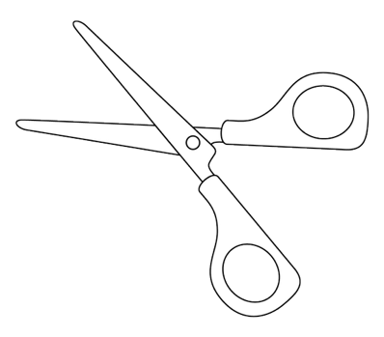
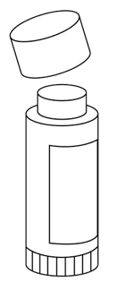

BUILD A HEALTHY PLATE
You will need:
1 paper plate
Magazines or food catalogues
Scissors
Glue
What to do:
Create a healthy plate by cutting out pictures of healthy food and gluing them onto your plate.

Slide 18
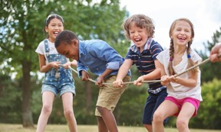
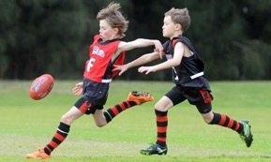
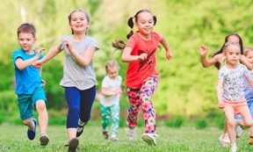
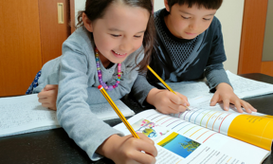
WHY IS IT IMPORTANT TO BE ACTIVE?
Mental health
Physical health
Overall wellbeing
Brain power
Makes us feel less stressed and worried.
Puts us in a good mood.
Makes us feel happy.
Puts a smile on our face.
Makes our heart, muscles, and bones strong.
Keeps our body healthy.
Gives us more energy to play and have fun.
Helps us enjoy life more.
Helps our brain work better.
Makes us better at solving puzzles and problems.
Let’s us think of new and fun ideas.

Slide 19

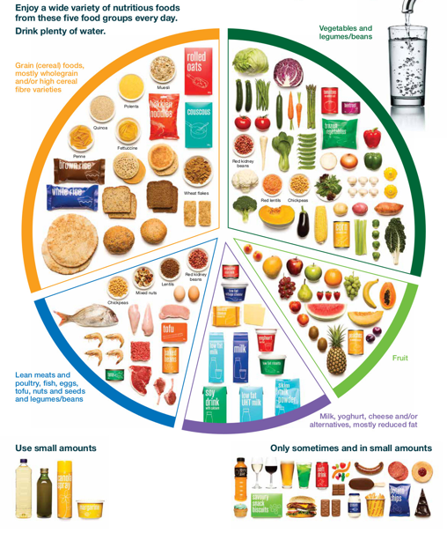
THE FIVE FOOD GROUPS
It’s important to eat a wide variety of nutritious foods from each food group every day. And to drink plenty of water.
Vegetables and Legumes/Beans
broccoli, carrots, spinach, sweet potato, tomato
Has lots of fibre, vitamins and minerals which help fight disease and keep us healthy. It is important to eat a variety of different coloured vegetables every day because they help our bodies in different ways.
Did you know that green vegetables are full of nutrients that protects and keeps our eyes healthy?
Daily serves: 5 serves
Fruit
apple, banana, kiwi, orange, pear
Has lots of vitamins, minerals and fibre which help our blood vessels, bones and skin stay healthy. It has lots of water that makes us feel fuller. Different coloured fruits help our bodies in different ways.
Did you know that blue and purple fruits help our brain and heart health?
Daily serves: 2 serves

Slide 20
THE FIVE FOOD GROUPS
Grains
bread, rice, pasta, oats, corn, barley
Give us the energy we need to play and learn and for our bodies to function properly. They have carbohydrates, which are like fuel for our bodies.
Daily serves: 4 serves
Proteins
chicken, beef, fish, eggs, tofu, nuts, legumes
Has lots of protein and iron. Protein helps our muscles and body grow strong and repair themselves. If we hurt or cut ourselves it helps us heal. Proteins are also important to eat the day before exercise or playing footy to help give you lots of energy.
Daily serves: 1.5 serves
Dairy and Alternatives
milk, yoghurt, cheese, soy milk, almond milk
Dairy has calcium which helps build strong bones and teeth grow stronger.
Daily serves: 2 serves

Slide 21



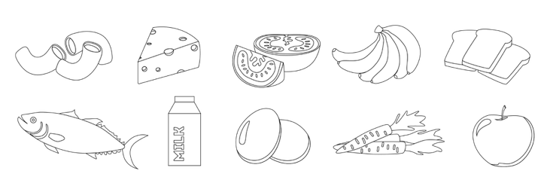
THE FIVE FOOD GROUPS
Instructions
Colour and cut out each of the foods at the bottom of the page.
Glue each food onto the correct part of the plate.
Put a circle around the ones we could grow in our garden.
Draw and name another food you can add to each food group.
Grains
Vegetables
Proteins
Fruits
Dairy

Slide 22


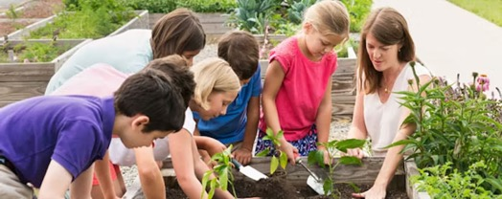
GARDENS
Discuss:
Do you or someone you know have a garden?
What types of foods do you grow in it?
What are the benefits of having a garden?
If an AFL Club had a garden, what do you think they would grow?
Should schools have gardens? | How could a garden at school help us lead a healthy life? | What types of foods from the five food groups could be grown in the garden? | If an AFL Club had a garden, what do you think they would grow?

Slide 23






GARDEN DESIGN CHALLENGE
Design a garden that makes our school look nice and helps everyone eat healthy foods so we have lots of energy to stay active!
1.
ASK
2.
IMAGINE
PLAN
3.
What’s the problem?
Brainstorm!
Choose a solution.
Draw it!
Make a materials list.
4.
CREATE
5.
IMPROVE
Make it!
Try it out.
Make it better!

Slide 24
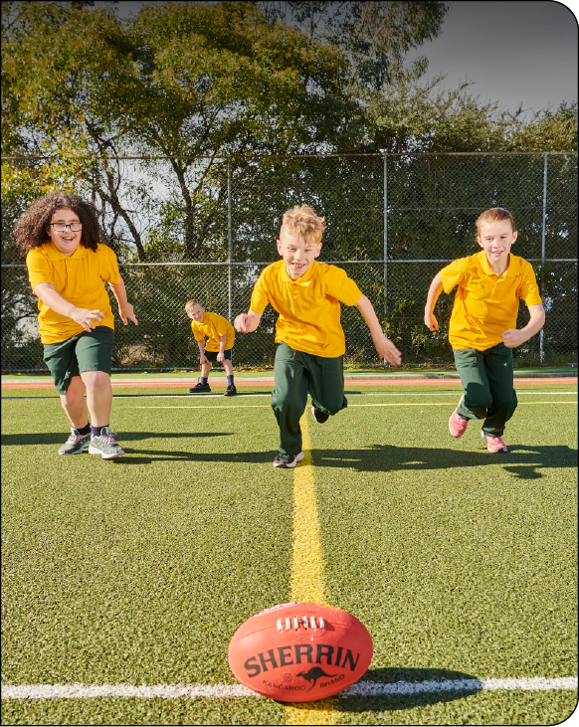

LESSON 2: HEALTHY FOOD CHOICES
Learning intention
In this lesson we will learn why it is important to build strength for our mental and physical health. Explore the connection between health messages, symbols, and food choices. Identify the problem in our Garden Design Challenge and brainstorm ideas to solve it.
Success criteria
I will know I am successful when I can:
Participate in strength activities
Identify healthy food choices
Brainstorm ideas to solve a problem

Slide 25

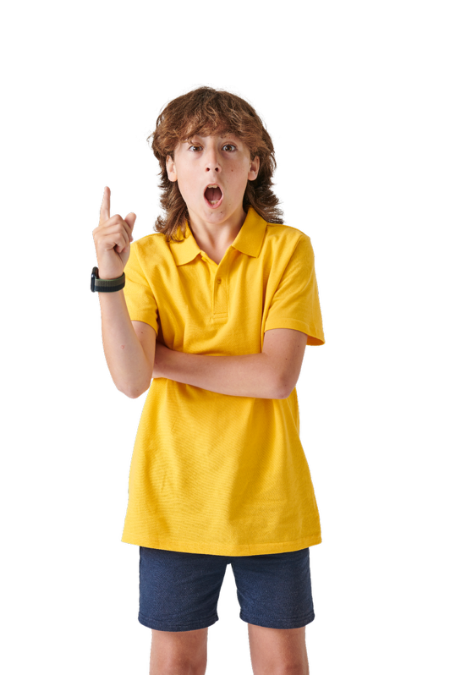
GUIDING QUESTIONS
GUIDING QUESTIONS
What is the purpose of the different health messages used in food advertising and packaging?
What is the purpose of the different health messages used in food advertising and packaging?
What should be included in a school or home garden?
What should be included in a school or home garden?
How do health messages on food influence your food choices?
How do health messages on food influence your food choices?
How can our garden encourage us to make healthy food choices?
How can our garden encourage us to make healthy food choices?
How does eating healthily make you perform better on the footy ground?
How does eating healthily make you perform better on the footy ground?

Slide 26


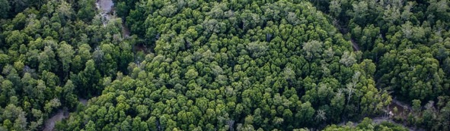


VOCABULARY
SYMBOL
BRAINSTORM
SYMBOL
BRAINSTORM
A special sign or picture that means something.
When you think of lots of fun and creative ideas together.
ENVIRONMENT
MENTAL HEALTH
ENVIRONMENT
MENTAL HEALTH
The world around you - air, land, animals and plants.
Taking care of your feelings.
PHYSICAL HEALTH
Can you think of any other words that might be important?
PHYSICAL HEALTH
Taking care of your body.

Slide 27
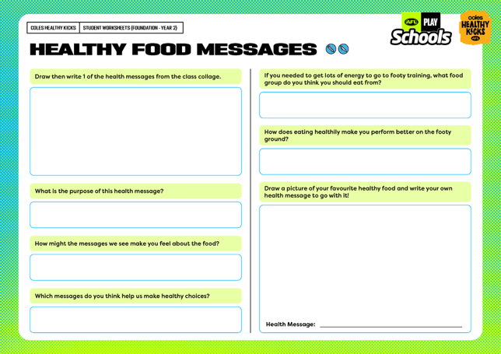

HEALTHY FOOD MESSAGES WORKSHEET
What health messages do you see on the class collage we made of health messages, symbols and images?
What should be included in a school or home garden?
Why do you think these messages are on food packages or in advertisements?
How do health messages on food influence your food choices?
How might these messages make you feel about the food?
How can our garden encourage us to make healthy food choices?
Do these messages make you want to eat the food?
Why or why not?
How can our garden encourage us to make healthy food choices?
Which messages do you think help us make healthy choices?
How can our garden encourage us to make healthy food choices?

Slide 28
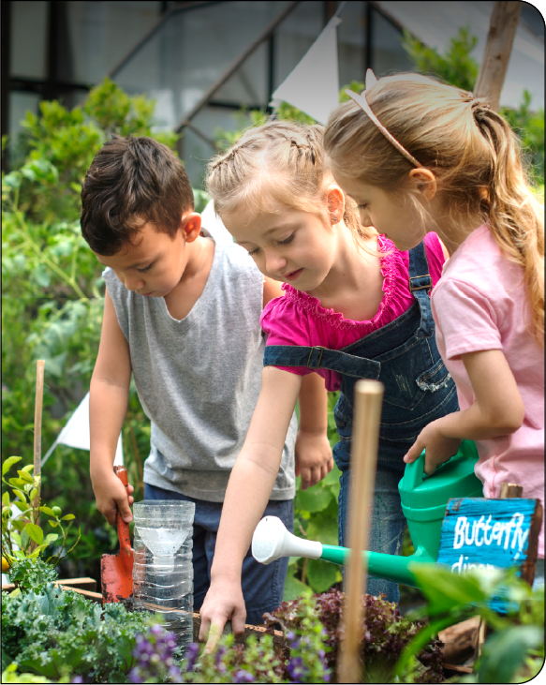



GARDEN DESIGN CHALLENGE
Design a garden that makes our school look nice and helps everyone eat healthy foods so we have lots of energy to stay active! so we have lots of energy to stay active!
1.
ASK
What’s the problem?
2.
IMAGINE
Brainstorm!
Choose a solution.

Slide 29
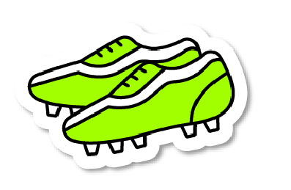
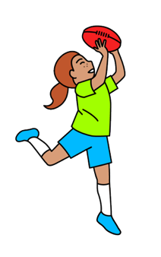
DESIGN - IMAGINE
Design a garden that makes our school look nice and helps everyone eat healthy foods so we have lots of energy to stay active! So we have lots of energy to stay active!
Draw and write your ideas in the box.

Slide 30
GARDEN DESIGN CHALLENGE
Self reflection
Imagine: What are your ideas for this challenge?
Improve: What changes could improve your design?
Design: Draw and label your design. Create it.
What did you like best about your garden design?
Reflect: Talk to your partner. What did you learn from the activity? What did or didn't work?
Test: Did your design work?
Yes
No

Slide 31
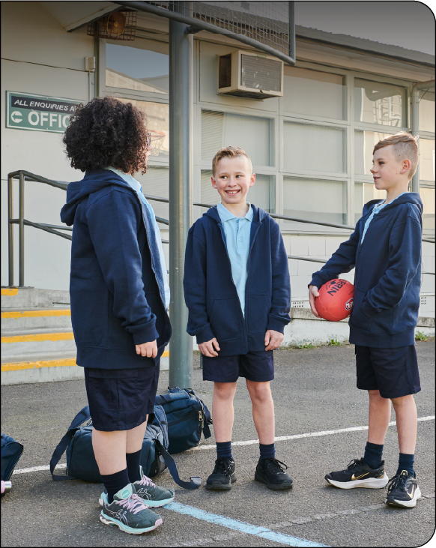

LESSON 3: HYDRATION AND SUSTAINABILITY
Learning intention
In this lesson we will learn why it is important to stay hydrated and about the sustainable practices we can follow in our lives when it comes to making healthy food choices.
Success criteria
I will know I am successful when I can:
Participate in cardiovascular activities
Create a health message around the importance of staying hydrated
Draw a plan of the garden for the garden design challenge

Slide 32


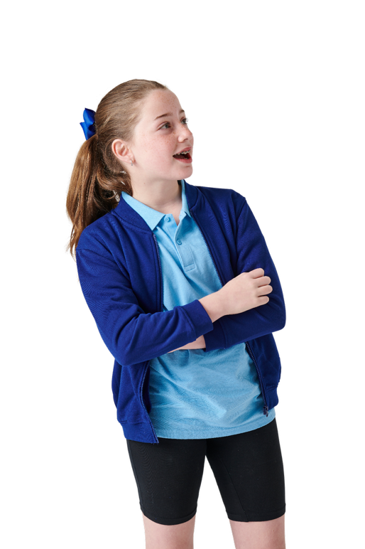
GUIDING QUESTIONS
GUIDING QUESTIONS
Why is it important to drink water especially before, during and after playing footy or doing exercise?
Why is it important to drink water especially before, during and after playing footy or doing exercise?
Which fruit and vegetables are grown locally?
Which fruit and vegetables are grown locally?
What are the basic needs of plants, animals and humans?
What are the basic needs of plants, animals and humans?
Which fruit and vegetables are grown according to the seasons?
Which fruit and vegetables are grown according to the seasons?
How can choosing local and seasonal foods benefit our health and the environment?
How can choosing local and seasonal foods benefit our health and the environment?

Slide 33
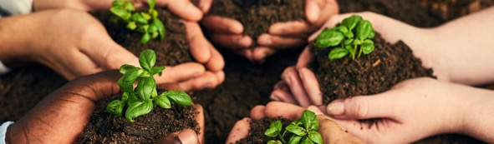

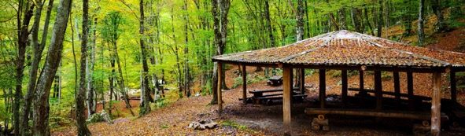

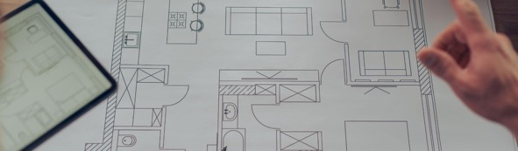

VOCABULARY
SUSTAINABILITY
HYDRATION
Taking care of our planet so that people in the future can also enjoy it. It means being kind to nature and using things carefully.
Putting water into your body so you don't feel thirsty. Water also helps transport nutrients and oxygen around our bodies.
SUSTAINABILITY
HYDRATION
SHELTER
SEASONS
A safe place that keeps you protected from rain, wind, and cold. It can be a house, a tent, or even a tree that helps you stay safe.
SHELTER
SEASONS
The four different times of the year - Spring, Summer, Autumn, and Winter - when the weather changes.
PLAN
MATERIALS
PLAN
MATERIALS
A way to think about what you want to do before you do it.
Things you use to make or build something, like wood, paper, or clay.

Slide 34

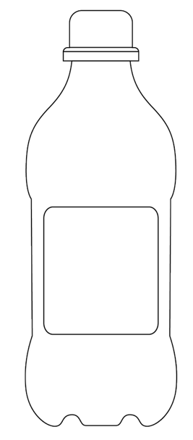
THE FIVE FOOD GROUPS
Instructions
Decorate your water bottle to remind everyone to stay hydrated.
Include:
a symbol that shows water is good for you
a short message that encourages others to drink water
Why did you choose this symbol?
Why did you choose this message?
Why do you think it's important to stay hydrated before, during and after exercise?

Slide 35

WHAT ARE OUR BASIC NEEDS
Needs:
Humans
Plants
Humans
Plants
Water
Sunlight
Soil
Food
Shelter
Air
Shelter
Water
Water
Food
Water
Food
Where does each need belong? Why?
Water
Food
Soil
Sunlight
Soil
Sunlight
Soil
Sunlight
Air
Air
Shelter
Shelter
Plants need water, sunlight, soil, and air
Air
Air
Animals need food, water, shelter, and air
Humans, as animals, share the same basic needs as other animals
Water
Sunlight
Soil
Water
Shelter
Food
Air
Food
Shelter
Air
All living things have interconnected needs and depend on each other for survival
Animals
Animals

Slide 36
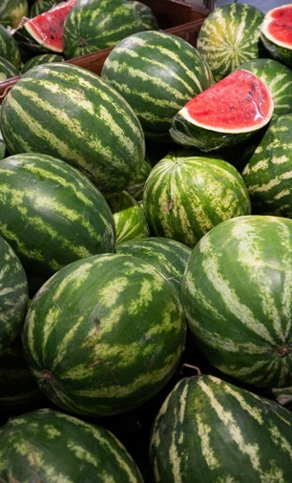
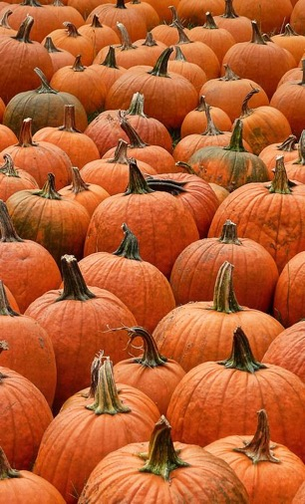
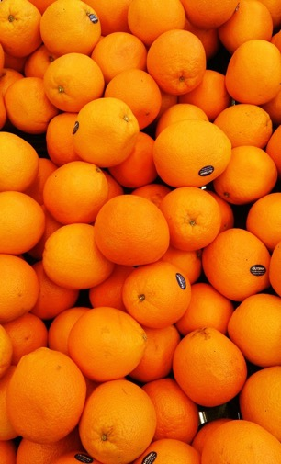
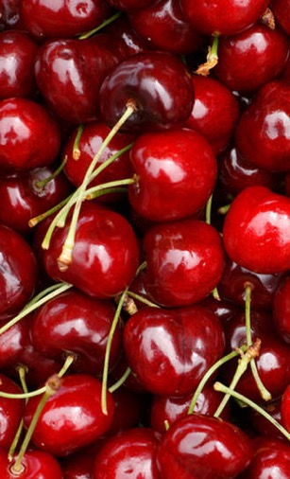
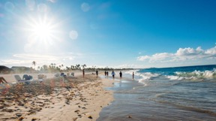
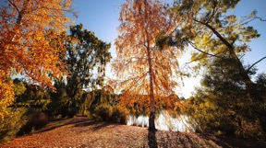
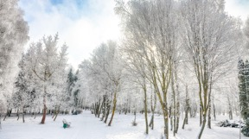
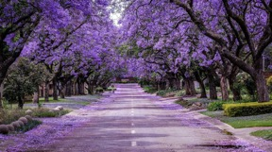
EATING FOR THE SEASON
Why do different fruit and vegetables grow in different seasons?
How can choosing local and seasonal foods benefit health and the environment?
SUMMER
AUTUMN
WINTER
SPRING
Pre season
Start of footy season
Middle of footy season
Footy finals time
WATERMELON
PUMPKIN
ORANGE
CHERRY
What am I?
I love the warm summer months
I am green on the outside
I am red and juicy on the inside
Sometimes I have small black or white seeds.
What am I?
As it starts to get cool I am ready for harvesting
Cook me up in some soup
Or carve me for a scary surprise.
What am I?
My name matches my colour
I come from the citrus family
I have lots of Vitamin C that helps you fight colds in winter.
What am I?
When you see me around you know the warmer months are starting
I am small, round and juicy
You often find me hanging out with a friend
I have a seed inside me hidden in a stone.

Slide 37




Pre season
Start of footy season
Middle of footy season
Footy finals time
EATING FOR THE SEASON (CON’T)
Some fruits and vegetables only grow in certain seasons.
Some fruits and vegetables are in season all year round.
Seasonal foods are fresher and have more flavour.
Eating seasonal foods supports local farmers and reduces transportation needs.
Seasonal eating is good for the environment.
Some fruits are best harvested during these seasons but it may depend on climate and where you live in Australia.
SUMMER
AUTUMN
Tomatoes
Watermelon
Nectarines
Capsicum
Corn
Figs
Plums
Pumpkins
Brussels sprouts
Pomegranate
WINTER
SPRING
Mandarins
Oranges
Leeks
Cauliflower
Turnips
Asparagus
Snow peas
Cherries
Strawberries
Spring onions

Slide 38

SUSTAINABILITY
Sustainability means taking caring of our world so that it stays healthy for a long time.
How can eating seasonally help our planet?
What small, positive choices can we make to help protect our planet?
Eating seasonally
Reduce, reuse and recycle
SUSTAINABILITY
Using resources wisely
Taking care of nature

Slide 39



GARDEN DESIGN CHALLENGE
Design a garden that makes our school look nice and helps everyone eat healthy foods so we have lots of energy to stay active!
Draw a plan of your garden.
Label the features.
Include where the best location for your garden would be in the school playground and explain why.
Create a list of materials your group will need to make a model of your garden.
PLAN
3.
Draw it!
Make a materials list.

Slide 40


LESSON 4: LET’S CREATE A GARDEN
Learning intention
In this lesson we will participate in balance activities and explore how plants are grown for food and how they can be incorporated into meals. We will create a model of our garden.
Success criteria
I will know I am successful when I can:
Participate in balance activities
Identify why balance training is important for my body
Choose healthy foods to grow in the garden
Prepare a healthy meal

Slide 41

GUIDING QUESTIONS
GUIDING QUESTIONS
Why do we need to do warm up and cool down activities when we exercise or play footy?
How do you feel when you are playing
footy or doing exercise?
What healthy foods can we grow in our garden?
What do we need to consider when we choose them?

Slide 42





VOCABULARY
PRODUCE
RECIPE
Something this is made or created, like eggs from a chicken or milk from a cow. Fruit and vegetables are also called produce.
PRODUCE
RECIPE
Instructions that tells you how to cook something.
INGREDIENTS
METHOD
The things you need to make a food. These are the also items listed on a food label that tell you what is inside.
INGREDIENTS
METHOD
The steps and instructions that tell you how to do something.
BENEFIT
Can you think of any other words that might be important?
BENEFIT
Something good that helps you or makes something better.

Slide 43
WHAT CAN WE GROW IN OUR GARDEN?
What healthy foods can we grow in our garden? | What do we need to consider when we choose our foods? | What meals could we make with the foods we grow?

Slide 44






WHAT PARTS DO WE EAT?
CARROT
CELERY
TOMATO
Roots
Stems
Fruits
LETTUCE
BROCCOLI
PEAS
Leaves
Flower
Seeds

Slide 45


GARDEN DESIGN CHALLENGE
Design a garden that makes our school look nice and helps everyone eat healthy foods so we have lots of energy to stay active!
How can you test or try out your design to see if it solves the original problem?
4.
CREATE
Make it!
Try it out.

Slide 46

GARDEN DESIGN CHALLENGE
Peer assessment checklist
This design has a good mix of vegetables.
All plants can be reached for care and harvesting.
Yes
No
Yes
No
Comment:
Comment:
There is enough space between plants for them to grow.
The garden design makes our school look nice.
Yes
No
Yes
No
Comment:
Comment:
Sun loving plants are in sunny spots.
The garden encourages children to make healthy choices.
Yes
No
Yes
No
Comment:
Comment:
All plants can be easily watered.
Yes
No
Comment:

Slide 47




SMOOTHIE TIME
INSTRUCTIONS
Combine all your favourite ingredients in a blender and blend until smooth. Add more water until desired consistency is reached.
Greens and banana smoothie
Berries and coconut water smoothie
INGREDIENTS
INGREDIENTS
2 handfuls of spinach
2 handfuls of kale
1 green apple
½ cup frozen pineapple
1 banana
1 cup frozen berries
1 cup coconut water
¼ coconut yoghurt
1 banana

Slide 48


LESSON 5: SNACK ATTACK
Learning intention
In this lesson we will enjoy a healthy, fun fitness circuit, prepare nutritious snacks and present our garden designs to the class.
Success criteria
I will know I am successful when I can:
Participate in a fun fitness circuit
Discuss ways to make fitness fun
Make healthy choices when preparing snacks
Present my garden design to the class

Slide 49
GUIDING QUESTIONS
GUIDING QUESTIONS
How does exercise make you feel and why is it important for you?
How do you feel when you are playing
footy or doing exercise?
What did you like best about your garden design?
What would you change and why?
What did you learn?

Slide 50





VOCABULARY
CIRCUIT
FEEDBACK
A special exercise route where you do different activities in order, like jumping, running, and stretching.
CIRCUIT
FEEDBACK
When someone tells you how you are doing gives advice on how to to improve something you are doing.
RECOMMENDATIONS
NUTRITIAN
The healthy food and drinks that help your body grow strong and stay healthy. It means eating good things that give you energy.
RECOMMENDATIONS
NUTRITION
Suggestions or advice about what might be good for you to do or try.
SEEDS
Can you think of any other words that might be important?
Tiny objects that can grow into plants when they are put in soil and given water and sunlight. They are like little baby plants waiting to start growing.
SEEDS

Slide 51
POST QUIZ
How does physical activity make you feel and why is it important?
How does physical activity make you feel and why is it important?
4. How does being active help us at school or home?
A) Happy
B) Tired
C) Excited
D) All of the above
A) It makes us feel good
B) It helps us focus better
C) It gives us energy
D) All of the above
☑
☑
2. What is your favourite way to be active?
5. Why is it important to be active every day?
A) Running
B) Dancing
C) Playing sports
Can you name some more?
A) It helps us stay healthy
B) It makes us happy
C) It gives us energy
D) All of the above
☑
3. Why is it important to move our bodies every day?
6. How have your thoughts around exercise changed or stayed the same?
A) To stay healthy
B) To have fun
C) To make friends
D) All of the above
☑

Slide 52

GARDEN DESIGN CHALLENGE
Design a garden that makes our school look nice and helps everyone eat healthy foods so we have lots of energy to stay active!
What feedback did I receive that I can use to improve my design and make it better?
What recommendations did I receive that I can use to improve my design and make it better?
5.
IMPROVE
Make it better!

Slide 53





SUSTAINABILITY TIPS
How can we use our vegetable scraps to promote sustainability?
Garlic
Plant a garlic clove with the pointy end up into soil or put it in water until roots grow.
Celery
Cut the bottom of a celery stalk and place it in a bowl of water. Put it in sunlight. Soon, new leaves will grow!
Lettuce
Save the bottom part of the lettuce and put it in a bowl of water, cut side up. Keep it in sunlight to grow new leaves.
Carrots
Cut off the tops of carrots (with some stem). Place them in a bowl of water, cut side down, and watch for new green leaves!
Herbs (like basil & mint)
Cut a stem about 3 inches long and put it in water. Once roots grow, you can plant it in soil.
Regrowing vegetable scraps helps the Earth by reducing waste, letting us grow new plants from leftovers instead of throwing them away.

Slide 54

PROGRAM DEBRIEF
PROGRAM DEBRIEF
What did you like best about your garden design?
What would you change and why?
What new thing did you learn?

Slide 55
3-2-1 EXIT TICKET
List three reasons why it is important to be active:
3
1.
2.
3.
List two reasons why we should make healthy food choices:
2
1.
2.
Give one reason why having a school garden would encourage children to eat to healthy food:
1
1.

Slide 56

SNACK ATTACK
Snack fruit salad with honey yoghurt
INGREDIENTS
INSTRUCTIONS
400g yoghurt
50g pepitas
50g sunflower seeds
50g walnuts
Combine the seeds and nuts on an oven tray. Roast for 5 minutes until toasted
Cut fruit and combine in a large mixing bowl
Serve fruit topped with yoghurt and the seeds for a perfect sweet snack
Fruit
1 apple
1 punnet of strawberries
1 punnet blueberries
1 bunch grapes
1 pineapple
1 kiwi fruit
1 orange

