Slide 1

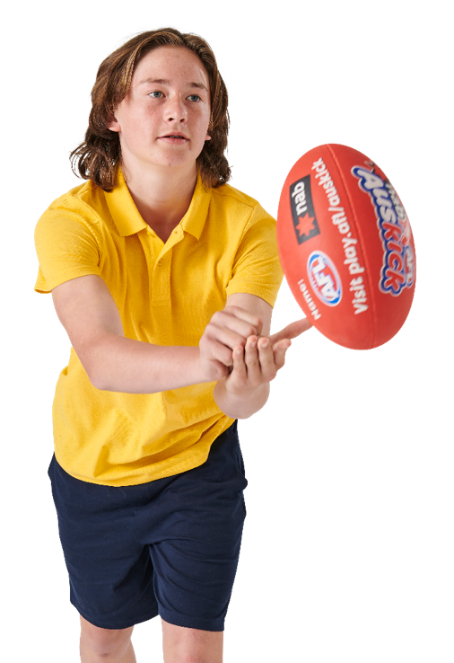




INTERACTIVE RESOURCE PACK
YEAR 3 -4

Slide 2


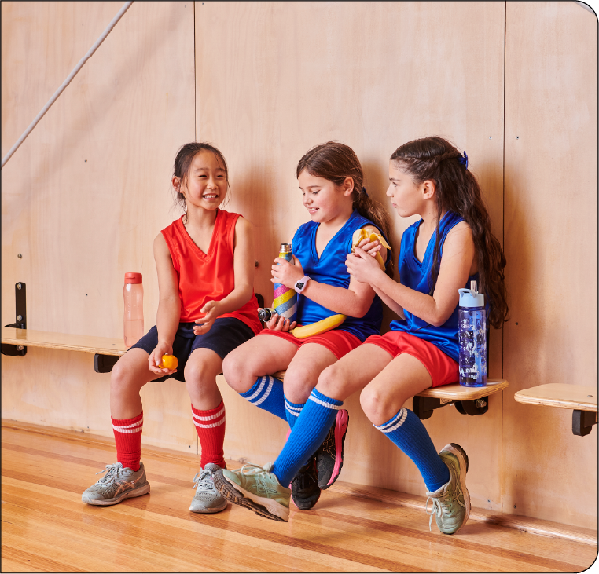
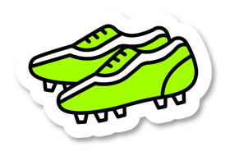
CONTENTS
Lesson 1:
Food marketing
Lesson 2:
Sustainable practices
Lesson 3:
Worm farms
Lesson 4:
Let’s investigate food wastage
Lesson 5:
Garden design presentations

Slide 3

AUSTRALIAN RULES FOOTBALL BALL SKILLS
Tags and Tails | 1 bib (or ribbon, sashes, etc) per student. Markers to mark out playing area Students spread out in the playing area, wearing bibs as tails. On ‘Go!’ students steal as many tails as they can from others while dodging to keep their own tail safe. Make sure no one tackles another player while trying to steal their tail. Once a student has two tails, they give their next tail to someone without a tail. The game ends when everyone has swapped tails a few times. Modified version The game is played in small groups with students only stealing one bib. Once they have had a bib stolen from them they are out of the game.
Mad Marks | 1 football per pair. Each student lines up opposite each other about one metre apart. For chest marks: One student gently throws the ball to their partner so their arms can hug the ball into their chest. For overhead marks: Have one student take a few steps back and hold the ball at shoulder height. Their partner runs forward and grabs it! For a ‘spectacular’ (speccy) mark: Have one partner hold the ball out to the side and higher than their shoulders. Have the other student run towards the ball and jump to try to grab it with their knees in the air (like a speccy)! After a few goes, have one student toss up the football (rather than holding it) for their partner to catch. Modified version Only focus on one skill per session.

Slide 4

AUSTRALIAN RULES FOOTBALL BALL SKILLS
Let’s Bounce | 1 football for each student. Collections of cones or markers. Students spread out in the playing area holding their football. Start with students kneeling on the grass with their football in their laps (backside resting on their heels). Everyone tries bouncing the ball on the grass in front of them. Straighten up while still kneeling and bounce the football. Try only kneeling on one knee. Now crouch and bounce. Next try walking around while bouncing the football. Move from walking to a jog and finally, running while bouncing the football. Modified version Depending on the students ability only do the initial simplified bouncing activities.
Foosball | 12 cones. Use the cones to create two lines across the middle of the activity square. Nominate two students to be taggers on each line. The other players all start on one edge of the square, facing the taggers. When you say ‘Go’, players try to run to the other end zone. The taggers can only move side to side along their lines, not backwards or forwards. If they tag a player, that player joins them on that line and becomes a tagger. Taggers can’t overtake each other along their line – their position is fixed like the figures on a Foosball table. Once they start to run, runners must keep moving forwards, and cannot go backwards. Once everyone is tagged, choose new taggers and start again Modified version Start half the players at the opposite end zone to have the game flowing both ways. Give the ‘attackers’ a ball to carry while moving from one end to the other. Then add bounces when they reach the end zone.

Slide 5
AUSTRALIAN RULES FOOTBALL BALL SKILLS
Sharks and Islands | Collection of footballs, cones (x4), bibs (x2), hoops per group (x2). Put two hoops inside the playing area. Beside the playing area, mark out the smaller ‘tag zone’ with four cones. Give two students bibs and the others one footy each. Students in bibs are the ‘sharks’ and are ‘it’. They tag the others. Students who make it inside the hoops (‘on the islands’) are safe. They can't be tagged by the sharks. But they're only allowed on the island for 3 seconds before they have to leave! When a student is tagged, they run to the tag zone (the four cones) and complete a footy skill (e.g. handball to themselves or complete five bounces). Once they complete the footy skill, they can go back to the game. For overhead marks: Have one student take a few steps back and hold the ball at shoulder height. Their partner runs forward and grabs it! For a ‘spectacular’ (speccy) mark: Have one partner hold the ball out to the side and higher than their shoulders. Have the other student run towards the ball and jump to try to grab it with their knees in the air. After a few goes, have one student toss up the football (rather than holding it) for their partner to catch. Adjust the number of sharks or hoops so that it works best for your group. Swap the sharks every now and then so everyone gets a go at tagging the others. Modified version Have a student confident in ball skills help other students at the tag zone with the skills work. Slowly increase the number of sharks by giving out bibs to more students.
Collect the Coins | 2 footballs per team, 1 set of goal posts and a stack of coloured cones. Set up the goals on the edge of the playing area across from four different coloured cones. Each team lines up behind their own coloured cone. Randomly put cones in-between the teams and the goal posts. Make sure it’s the same amount for each team. On ‘Go’, the first member of each team kicks the football from their own coloured cone towards goal. If they score a goal, they run and collect one of their team’s coloured cones (their coins). If they don’t score a goal, they don’t collect a coin. Once the student has their football back, they run around the outside of the playing area and back to their cone. If they have a coin, they put it down by their cone. Wait until all four students are safely clear before the next four students have their shot for goal. The team that kicks all their goals and collects all their coins first, wins!

Slide 6
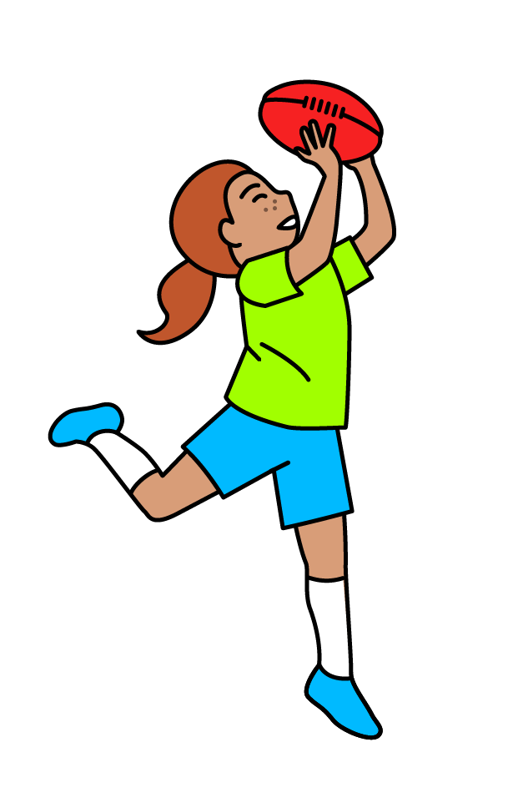

CHK VIDEOS : THE FIVE FOOD GROUPS

Slide 7
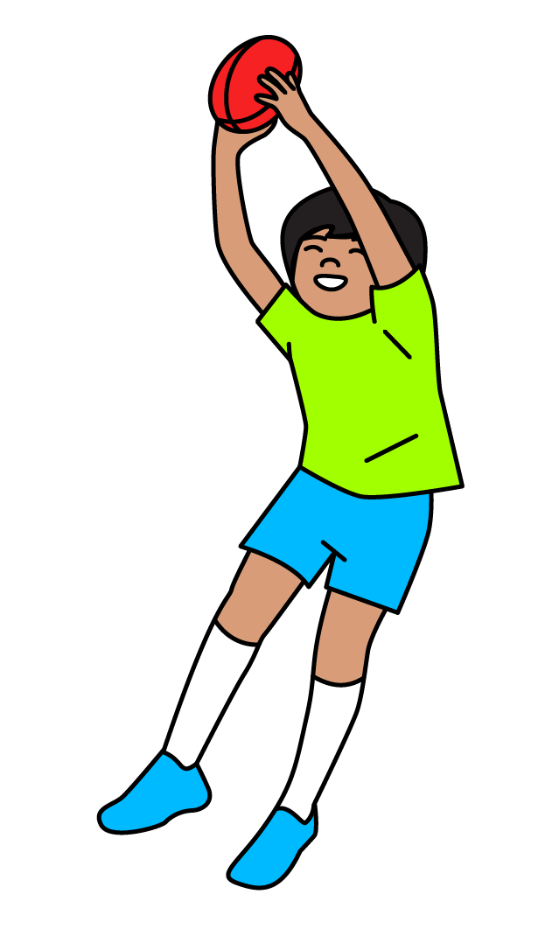
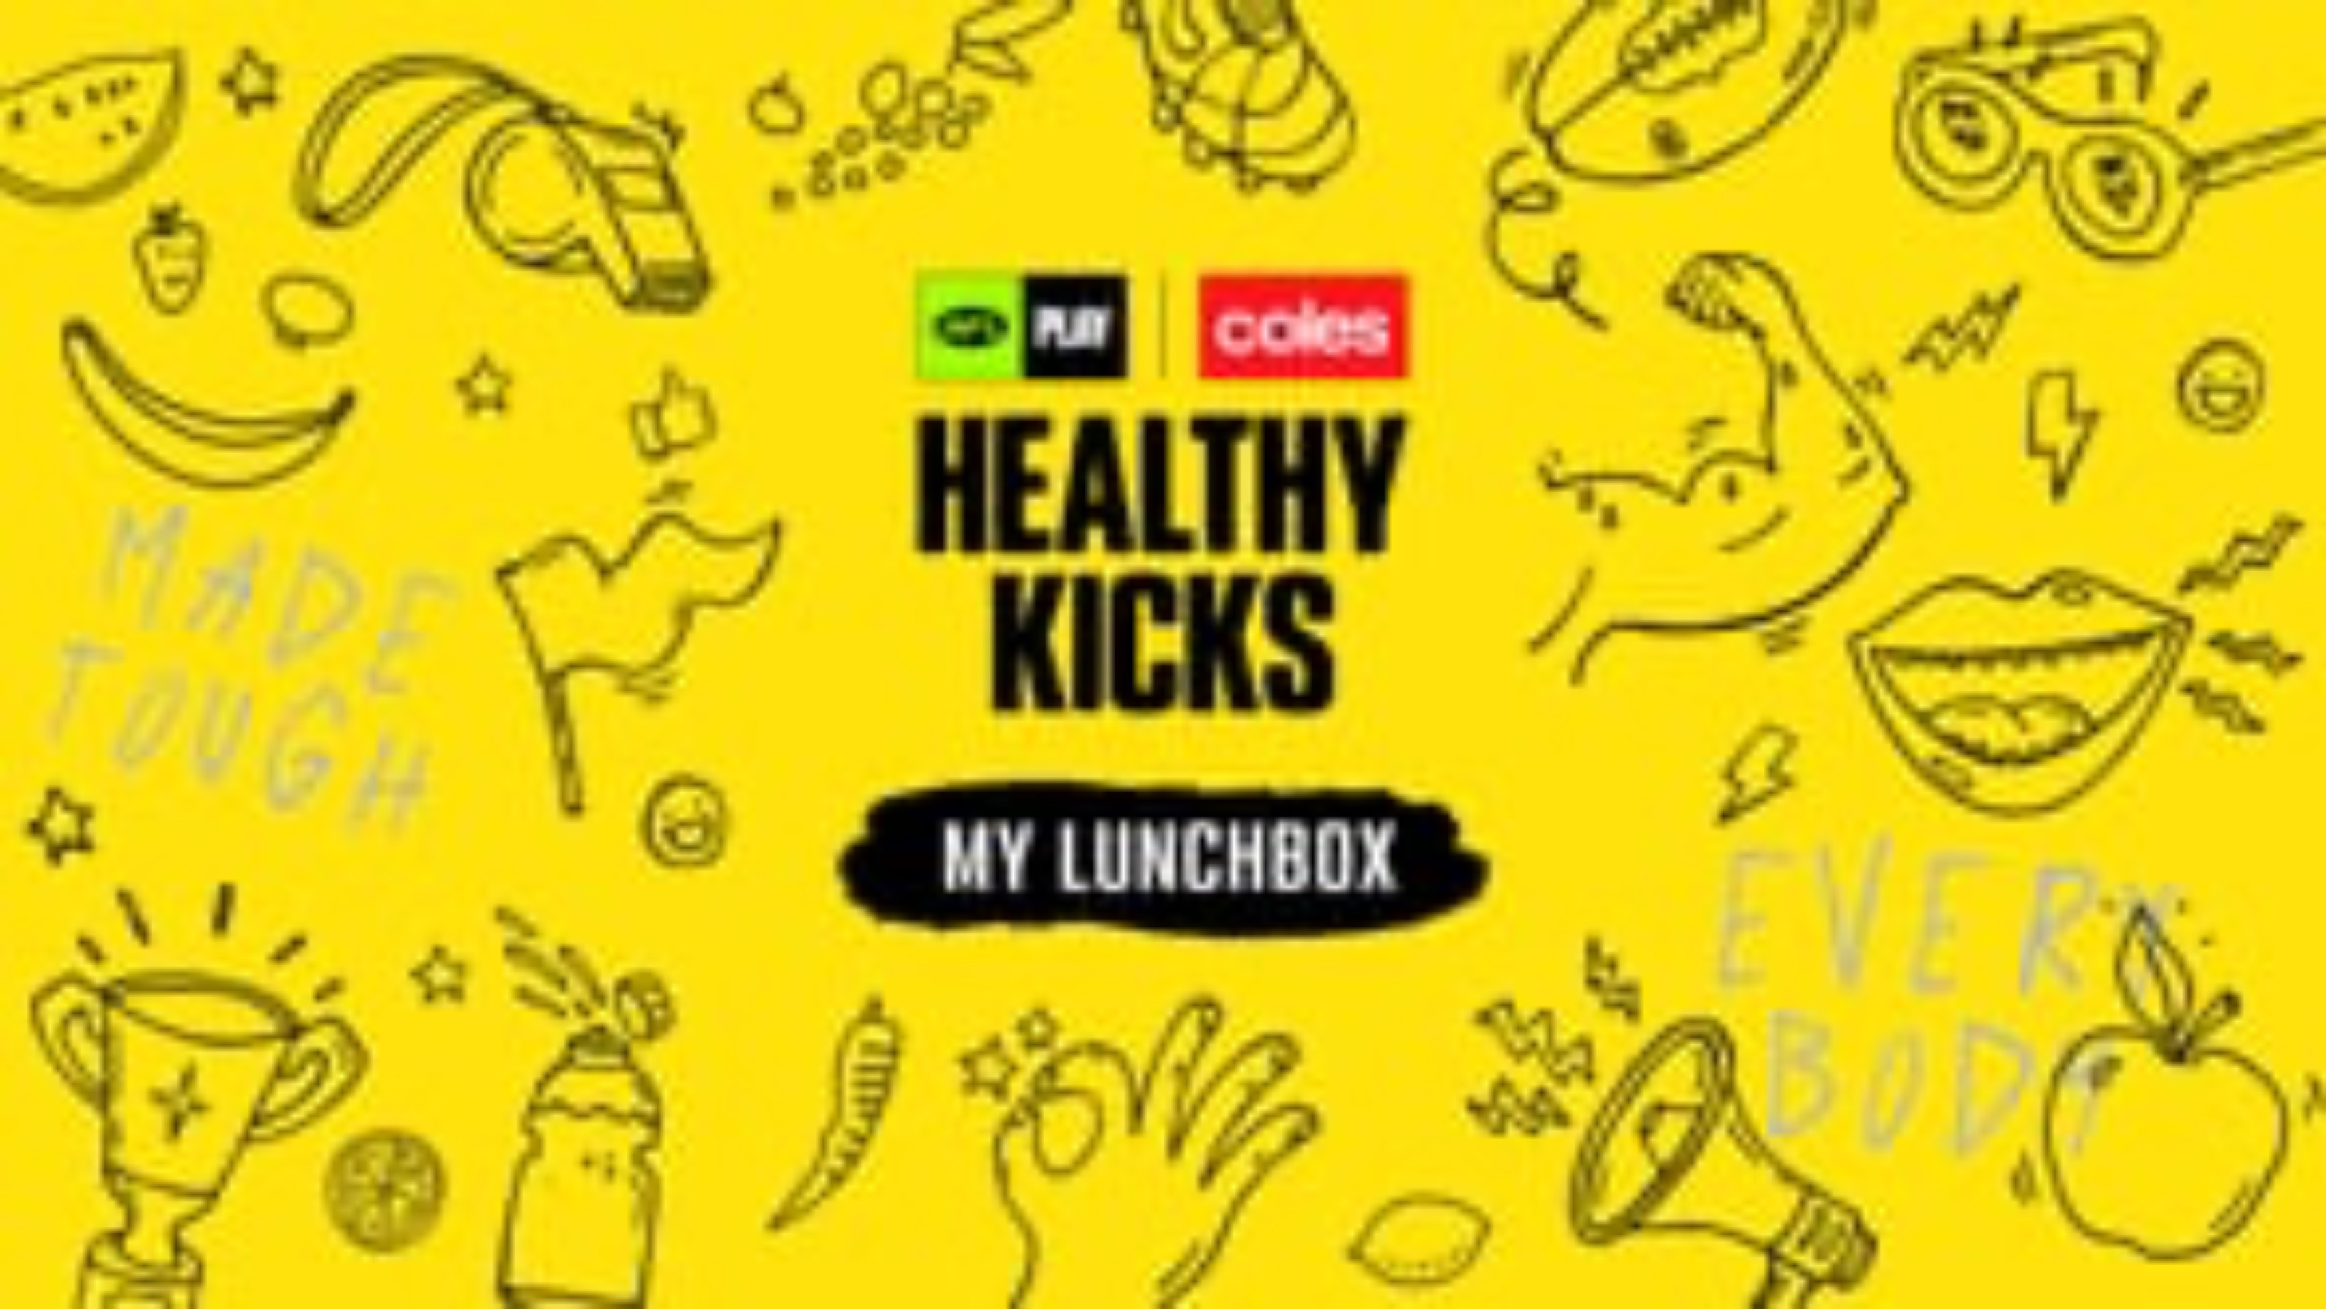
CHK VIDEOS : MY LUNCHBOX

Slide 8

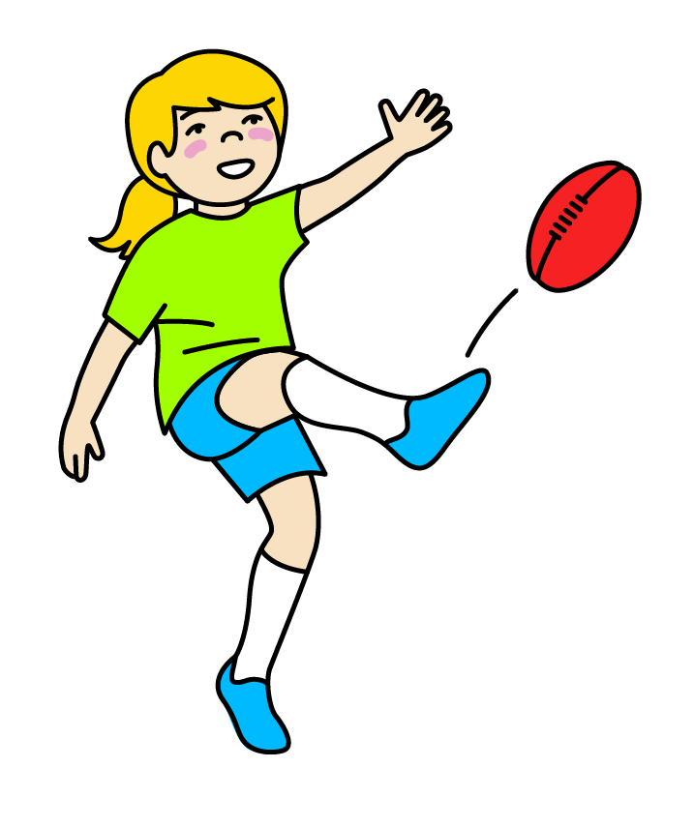
CHK VIDEOS : FUELING OUR BODIES

Slide 9

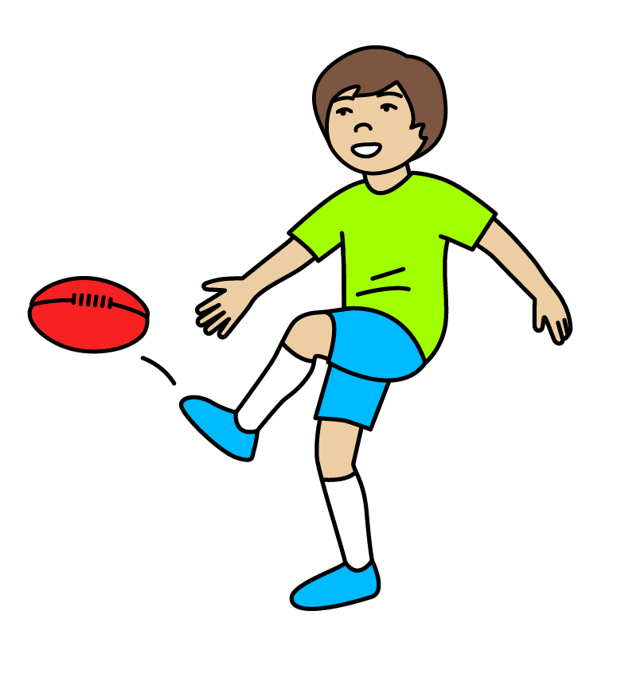
CHK VIDEOS : FOOD AND CULTURE

Slide 10

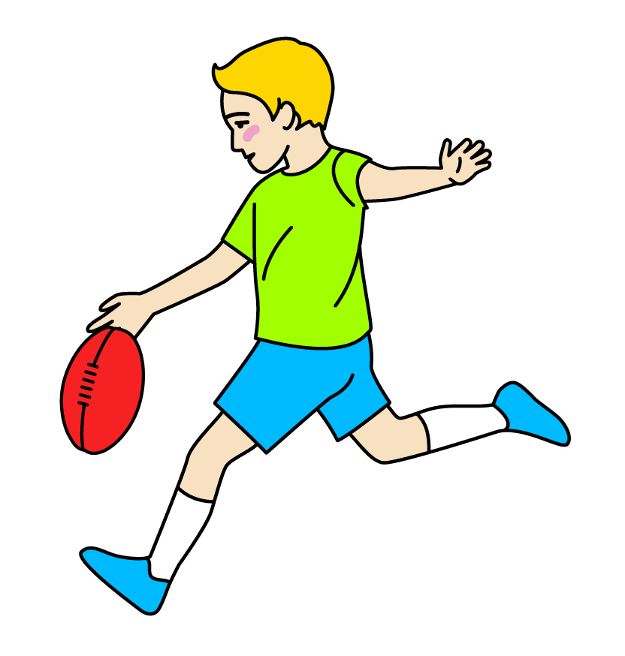
CHK VIDEOS : HYDRATION

Slide 11
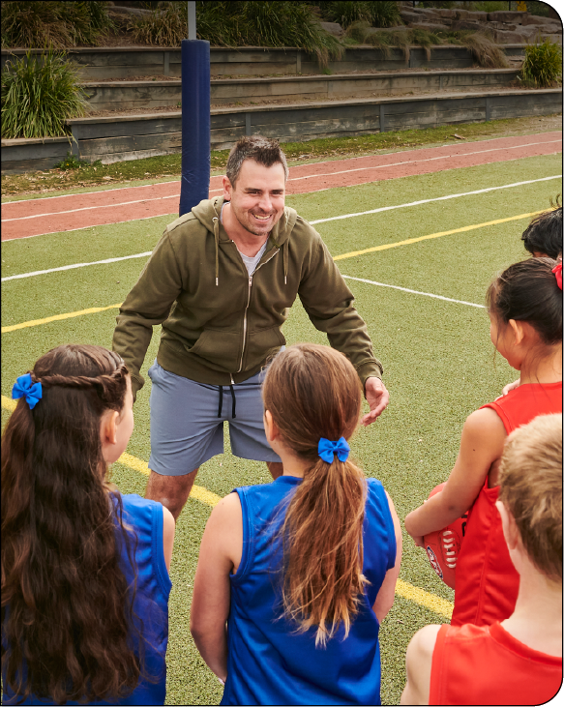

LESSON 1: FOOD MARKETING
Learning intention
In this lesson, we will participate in a variety of activities to get our bodies warmed up, mobile and flexible; and investigate food nutrition and how we are influenced in our food choices. We will define the key elements and the design process steps for our garden design challenge.
Success criteria
I will know I am successful when I can:
Participate in mobility and stretching exercises.
Identify why it is important to be active.
Interpret nutritional information and health messages.

Slide 12
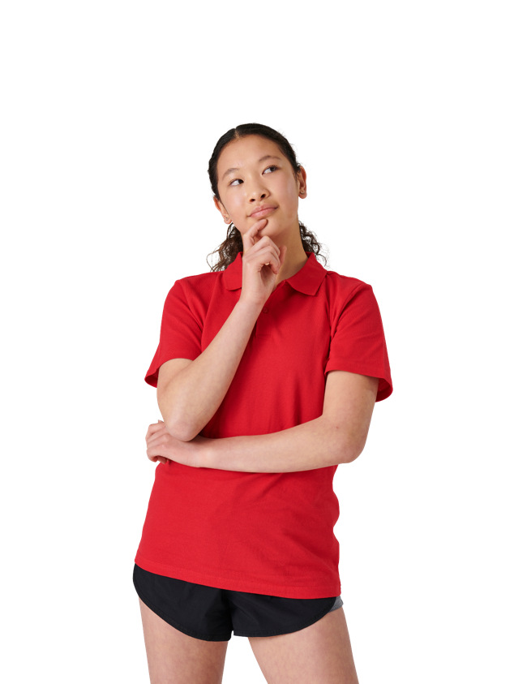

GUIDING QUESTIONS
GUIDING QUESTIONS
How do you feel when you are playing
footy or doing exercise?
How do you feel when you are playing
footy or doing exercise?
What role does advertising play in your food choices?
How do you feel when you are playing
footy or doing exercise?
How can we encourage our school community to eat healthily by enhancing our school environment?
How do you feel when you are playing
footy or doing exercise?

Slide 13
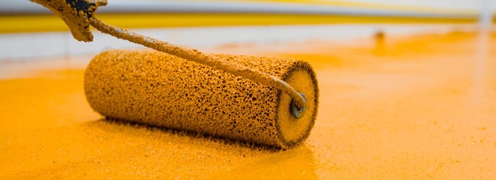
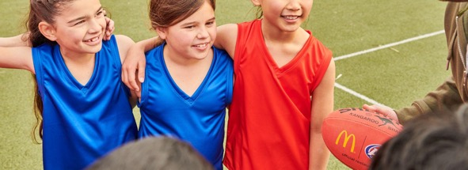
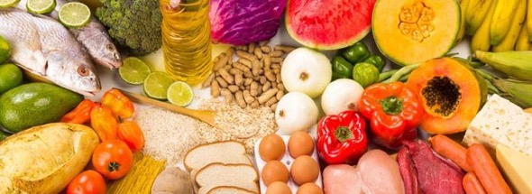
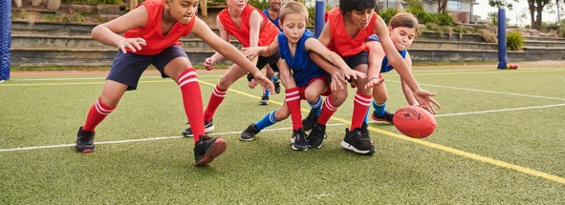
VOCABULARY
ENHANCE
MENTAL WELLBEING
ENHANCE
MENTAL WELLBEING
To make something better or improve it.
Feeling happy, calm, and good in your mind.
NUTRTITION
PHYSICAL WELLBEING
NUTRITION
PHYSICAL WELLBEING
The way food helps your body grow strong and healthy. Different kinds of foods help our body in different ways.
Taking care of your body, so you feel strong and healthy. It includes things like eating good food, playing outside, and getting enough rest.

Slide 14

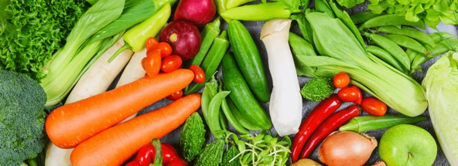

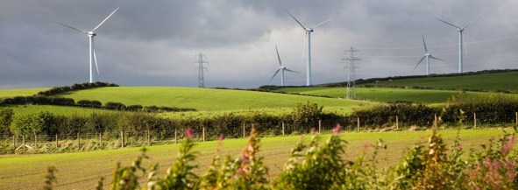
VOCABULARY
POSTURE
BALANCED DIET
POSTURE
Has two meanings. They are also pronounced differently.
Produce (noun): agricultural products like fruits and vegetables.
Produce (verb): making or creating something.
PRODUCE
How you sit or stand.
RECYCLE
SUSTAINABILITY
RECYCLE
SUSTAINABILITY
When we take something we don’t need anymore and turn it into something new.
Taking care of our planet so that people in the future can also enjoy it. It means being kind to nature and using things carefully.
Can you think of any other words that might be important?

Slide 15

KWL
Why do we need to play, move and eat healthy foods to help our body feel strong and happy?
K - What I know
W - What I want to know
L - What I learnt

Slide 16
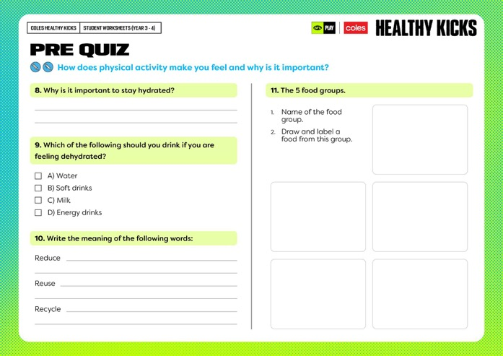
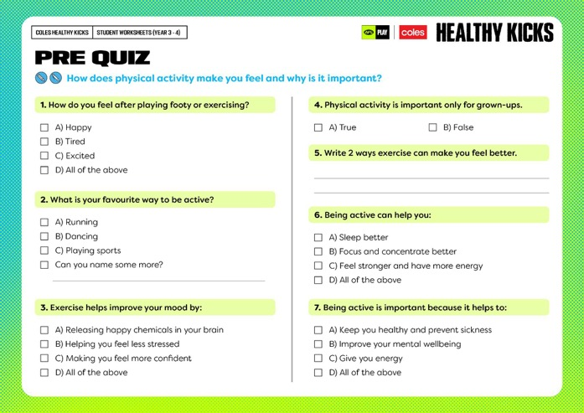


Slide 17



SCREEN TIME INTERVIEWS
How much time do we spend each day on devices?
How much time do we spend each day on devices?
What did you find out?

Slide 18

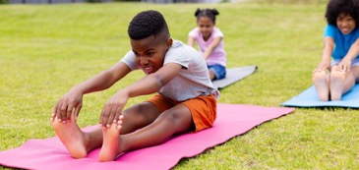
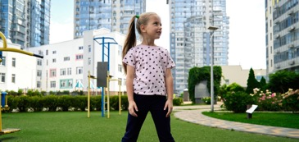
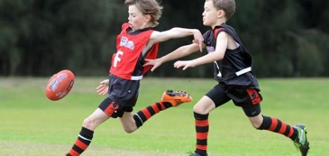
LET’S KEEP MOBILE AND FLEXIBLE
We spend so much time sitting watching TV and screens and this encourages bad posture; affecting the back, neck, shoulders and arms.
What can we do to address this?
Mobility and flexibility
What should be included in a school or home garden?
Doing back mobility exercises regularly gets us ready for playing footy and sport.
Keeps our back mobile, giving us a better range of motion and better posture.
Helps us recover from playing sport or running around on the weekend to prepare for the week ahead.

Slide 19
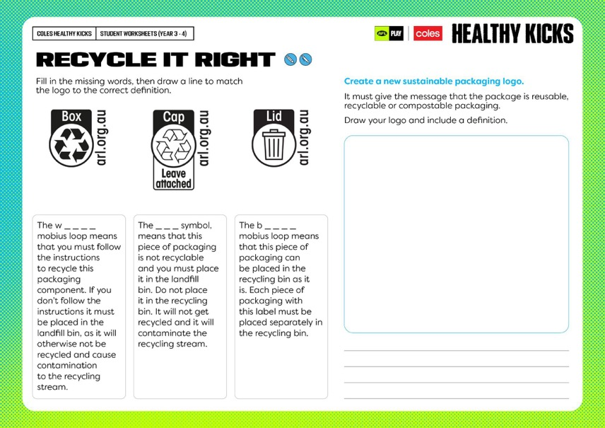
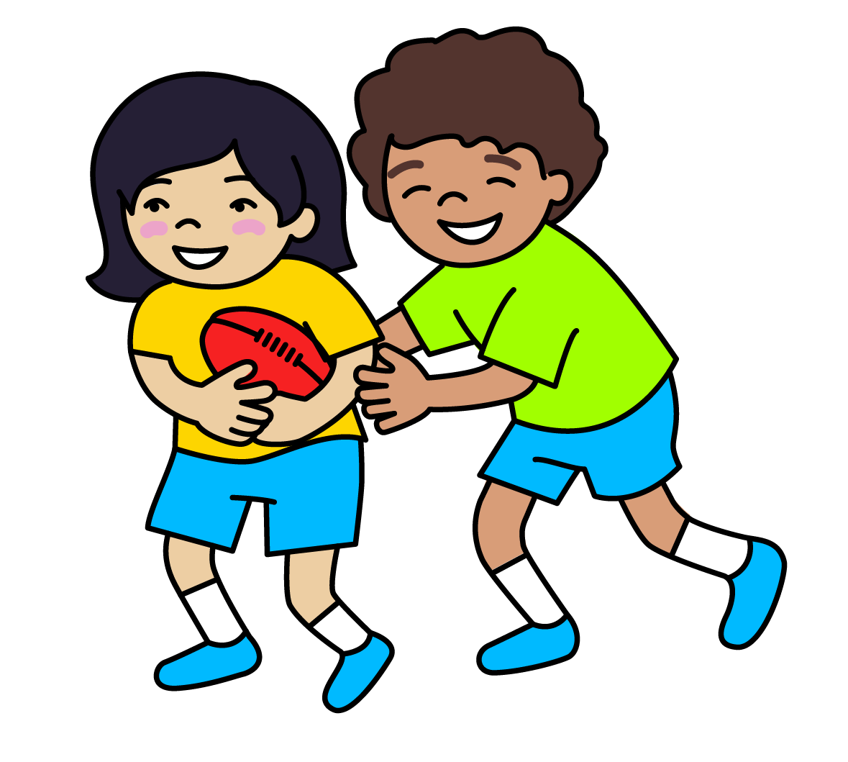
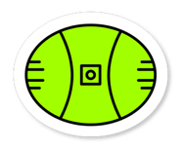

Slide 20
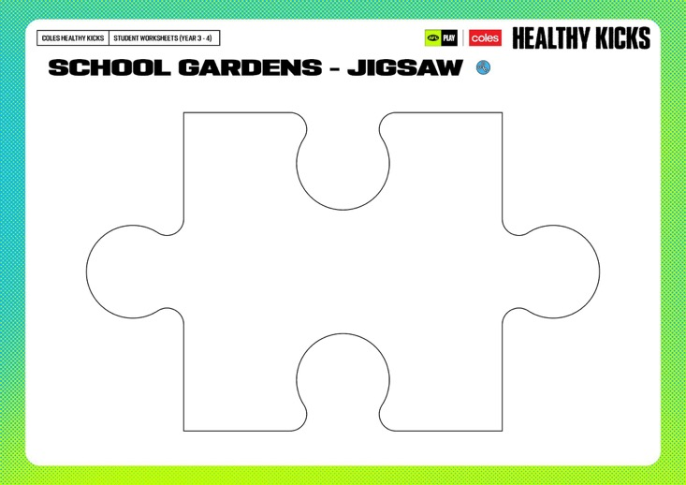
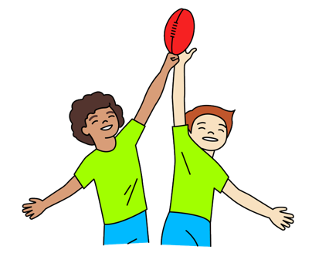
Instructions
Work in groups
Write your question on the front of the jigsaw piece
Record your answer on the back of the jigsaw piece
One person from each jigsaw group shares their information with each of the other groups.
Do you or someone you know have a garden at home? If so, what do they grow?
How can our garden encourage us to make healthy food choices?
What are the benefits of having a garden?
How could a garden help us to lead a healthy lifestyle?
If an AFL club had a garden, what types of foods from the five food groups do you think they would grow?
How can our garden encourage us to make healthy food choices?

Slide 21






GARDEN DESIGN CHALLENGE
Design a garden that makes our school look nice and helps everyone eat healthy foods so we have lots of energy to stay active!
1.
ASK
2.
IMAGINE
PLAN
3.
What’s the problem?
Brainstorm!
Choose a solution.
Draw it!
Make a materials list.
4.
CREATE
5.
IMPROVE
Make it!
Try it out.
Make it better!

Slide 22
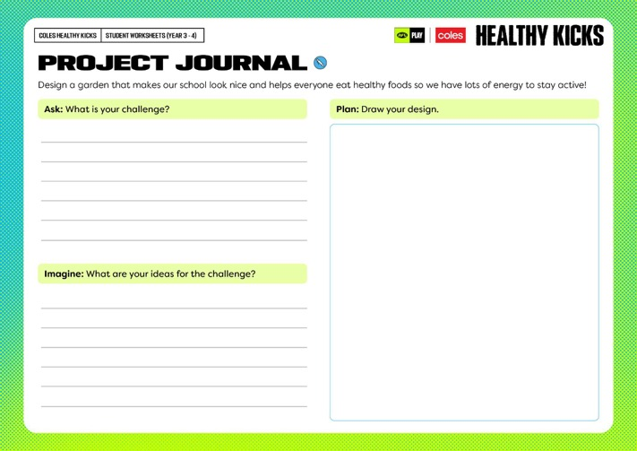
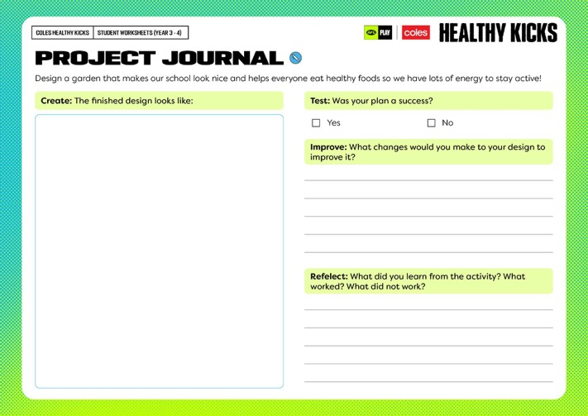


Slide 23
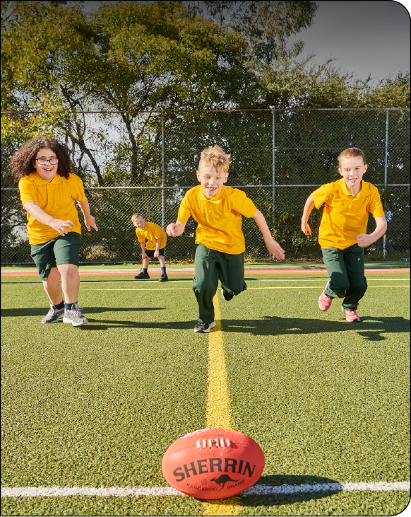

LESSON 2: SUSTAINABLE PRACTICES
Learning intention
In this lesson we will participate in a variety of activities to get our bodies warmed up, mobile and flexible. We will learn about composting and explore ways we can use our new knowledge in our garden designs.
Success criteria
I will know I am successful when I can:
Participate in warm-up and cool down strength activities
Explain why building strength is good for my mind and body
Identify the stages in the composting cycle
Brainstorm ideas and solutions to solve a problem

Slide 24

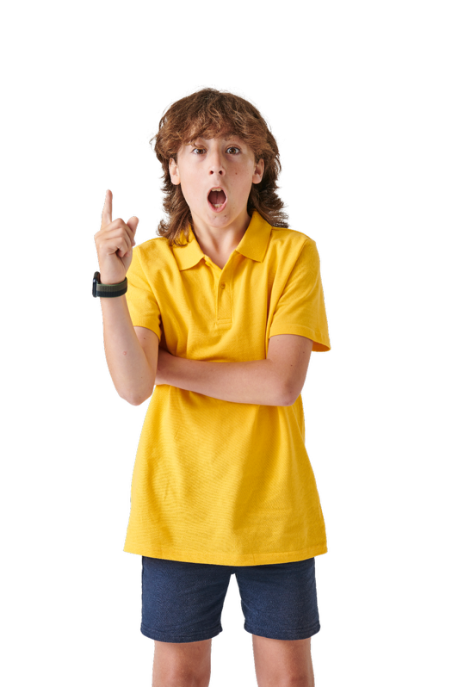
GUIDING QUESTIONS
GUIDING QUESTIONS
How can we encourage people in the school to eat healthily by enhancing our school environment?
How do you feel when you are playing
footy or doing exercise?
How does eating healthily help you to perform better on the footy field?
How do you feel when you are playing
footy or doing exercise?
How can we use our knowledge of sustainability and composting when designing our school garden?
How do you feel when you are playing
footy or doing exercise?

Slide 25

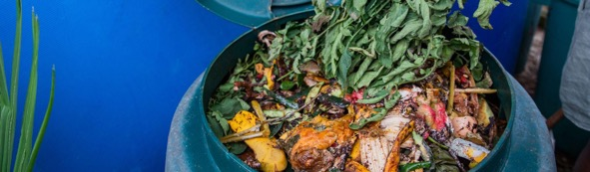

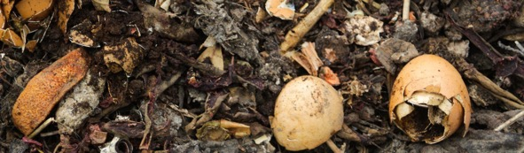


VOCABULARY
AERATE
COMPOST
AERATE
COMPOST
To add air to something.
A mixture of food scraps, leaves, and other organic waste that breaks down to make rich soil for plants.
CONSERVATION
DECOMPOSE
CONSERVATION
DECOMPOSE
Protecting the environment, animals, and natural resources to keep the planet healthy for the future.
When something, especially organic matter like food or plants, breaks down, rots or decays.
HYDRATION
MUSCLE
HYDRATION
MUSCLE
Putting water into your body so you don't feel thirsty.
Tissues in the body that help you move. They contract (get shorter) and relax (get longer) to make your body move.

Slide 26

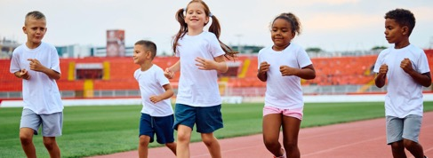
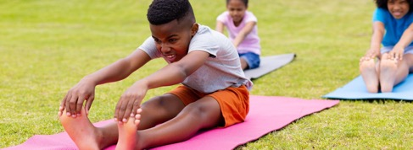
WARM UP - COOL DOWN
Why it is important to include warm up and cool down activities when playing footy or other sports?
WARM UP
COOL DOWN
Before playing footy or any sport, warming up gets your muscles ready to move and helps prevent injury.
Warming up can include things like stretching or jogging to get your heart pumping and your muscles ready for action.
Cooling down helps your body relax after playing.
Stretching and walking slowly can stop your muscles from getting sore and helps your body recover faster.
Think of it as getting your body ready for play and then helping it relax after!

Slide 27
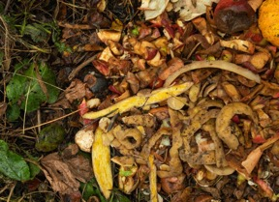
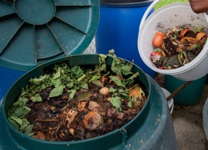
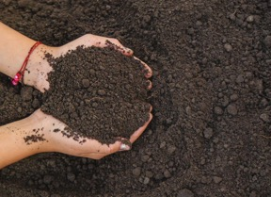
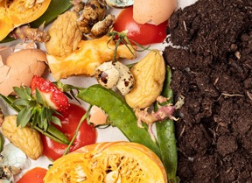
WHAT IS COMPOSTING
What happens when we throw away our food scraps?
What is composting?
Composting is like recycling food! Instead of going to the landfill, it turns into super-rich dirt for plants!
Composting helps us waste less food!
Composting your food and garden scraps is one of the easiest ways to look after the planet. You reduce greenhouse gas (GHG) emissions as well as feed your garden.

Slide 28
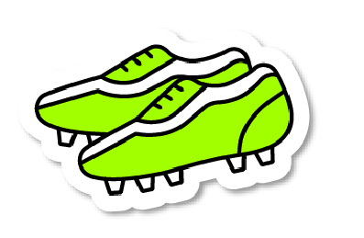
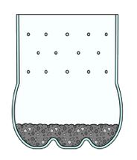
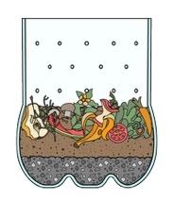
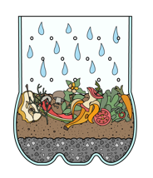
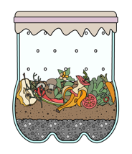
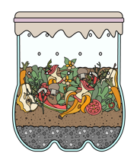
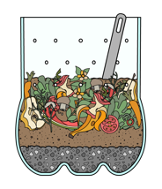
LET’S CREATE A COMPOST BIN
You will need:
Plastic bottle (cut in half with small holes punched in the sides and bottom), get an adult to do this for you at home.
Gloves
Small stones
Soil from the garden
Brown leaves
Paper - torn or shredded
Food scraps
Water in a spray bottle
Fabric
Elastic band
STEP 1
STEP 2*
STEP 3
Place a small layer of stones at the bottom of your bottle.
Add soil, brown leaves/ paper, food scraps and a small layer of soil.
Spray water to make it damp.
STEP 4
STEP 5
STEP 6
Use your piece of fabric and elastic to make a lid.
Feed your compost daily by adding scraps, leaves and paper.
Use a spoon to turn the compost weekly to aerate.
*Wear your gloves to layer the bin

Slide 29
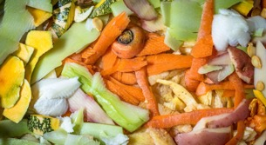
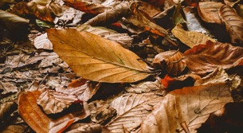

COMPOST BIN TIPS
Our bin needs:
Remember to feed our compost daily by adding scraps, leaves and paper.
How can our garden encourage us to make healthy food choices?
Turn the compost weekly to aerate. When we aerate soil, it helps plants grow by letting air, water, and food reach the roots.
How can our garden encourage us to make healthy food choices?
Green stuff
which is high in nitrogen
-fruit and vegetable scraps and peel
-fresh lawn clippings
-egg shells
-grass clippings
Brown stuff
which is high in carbon
-straw
-brown leaves
-shredded paper and/or cardboard
After 6 - 8 weeks
Our compost is ready when it looks like dark, crumbly dirt. Mix the compost into the garden beds.
How can our garden encourage us to make healthy food choices?
How can we record changes in the appearance, smell, and texture of your compost?
For your compost to work effectively, it should have the right ratio of carbon (60%) to nitrogen (40%).
DO NOT put meat, fish, branches, cheese or plastic in compost bins.

Slide 30

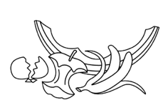
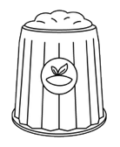



COMPOST BIN TIPS
Cut out and place the steps of the composting cycle in the correct order.
We eat fresh, yummy food.
We then produce food
scraps
... and throw them in a special bin
The food scraps decompose and turn into super healthy soil called COMPOST
Compost helps to make
healthy food grow, so we'll
have more to eat!
... and throw them in a special bin
The food scraps decompose and turn into super healthy soil called COMPOST
Compost helps to make
healthy food grow, so we'll
have more to eat!
We then produce food
scraps
We eat fresh, yummy food.

Slide 31


Slide 32




GARDEN DESIGN CHALLENGE
Design a garden that makes our school look nice and helps everyone eat healthy foods so we have lots of energy to stay active!
1.
ASK
What’s the problem?
2.
IMAGINE
Brainstorm!
Choose a solution.

Slide 33
IMAGINE
Design a garden that makes our school look nice and helps everyone eat healthy foods so we can have lots of energy to stay active!

Slide 34
HOW DOES OUR SCHOOL ENCOURAGE HEALTHY EATING
How does our school encourage healthy eating?
Problems
What are some problems you see?
Solution
Can you think of ways we can solve the problems we have?
New ideas
Can you think of any new ideas we can implement?

Slide 35


LESSON 3: WORM FARMS
Learning intention
In this lesson we will identify the benefits of cardiovascular training and the impact it has on our physical, mental and social wellbeing. We will investigate sustainable food practices we can use in our everyday lives and our garden.
Success criteria
I will know I am successful when I can:
Participate in cardiovascular activities.
Identify the effects exercise has on my mental and physical health.
Research sustainable food practices.

Slide 36



GUIDING QUESTIONS
GUIDING QUESTIONS
How does cardiovascular training affect our mental and physical wellbeing?
How do you feel when you are playing
footy or doing exercise?
What are some sustainable food practices we can use in our daily lives?
How do you feel when you are playing
footy or doing exercise?
How can using food scraps and worms help us live more sustainably?
How do you feel when you are playing
footy or doing exercise?

Slide 37


VOCABULARY
CARDIOVASCULAR
DEHYDRATION
CARDIOVASCULAR
DEHYDRATION
Relates to your heart and blood vessels that carry blood around your body.
It is when your body doesn’t have enough water, and you can feel thirsty or tired.
Can you think of any other words that might be important?

Slide 38

CARDIO TIME!
What are the benefits of cardiovascular training?
Strengthens the heart and lungs.
Burns
calories.
Improves energy levels.
Puts you in a good mood.
Is good for your mental health.
All of these will help with fitness and help to improve performance for all sports.
Did you know people can get sick less often when they exercise regularly as part of a healthy lifestyle?**
** Reference: Australian Government Department of Health and Aged Care; Better Health Channel - Victoria State Government Department of Health

Slide 39

THINK PAIR SHARE
THINK PAIR SHARE
How can using food scraps and worms help us live more sustainably?
How do you feel when you are playing
footy or doing exercise?
How can our garden encourage us to make healthy food choices?

Slide 40

WORM FARM TOUR
Worms let more air and water get into the soil.
How can our garden encourage us to make healthy food choices?
They love eating food scraps. They break this down into compost.
How can our garden encourage us to make healthy food choices?
Their poo and wee is full of nutrients which makes the soil healthy.
How can our garden encourage us to make healthy food choices?
Worms turn our garden soil into super soil which our fruit and vegetable plants love.
How can our garden encourage us to make healthy food choices?

Slide 41
WORM FARM TOUR
What can you put in a worm farm?
How can our garden encourage us to make healthy food choices?
What should you not put in a worm farm?
How can our garden encourage us to make healthy food choices?

Slide 42



Slide 43



GARDEN DESIGN CHALLENGE
Time to Plan
Design a garden that makes our school look nice and helps everyone eat healthy foods so we have lots of energy to stay active!
What do we need to do in the planning stage?
PLAN
3.
Draw it!
Make a materials list.

Slide 44




Slide 45




Slide 46


LESSON 4: LET’S INVESTIGATE FOOD WASTE
Learning intention
In this lesson we will participate in balance exercises and learn why they are important. We will investigate food wastage and sustainability and create a prototype of our garden design.
Success criteria
I will know I am successful when I can:
Participate in balance activities.
Explain why balance training is important for my body.
Identify ways to reduce food wastage.

Slide 47

GUIDING QUESTIONS
GUIDING QUESTIONS
Why is it important to include balance training when we exercise and play footy?
How do you feel when you are playing
footy or doing exercise?
How can composting and worm farming reduce food wastage and benefit our garden?
How do you feel when you are playing
footy or doing exercise?
What do we need to consider when creating a prototype or model of our garden design?
How do you feel when you are playing
footy or doing exercise?

Slide 48






VOCABULARY
ASSESSMENT
BALANCE
ASSESSMENT
BALANCE
A way to check how much you’ve learned or how well you can do something, like a test or quiz.
When something stays steady and doesn’t fall over.
DAIRY
FRUIT
DAIRY
FRUIT
Foods made from milk that help you grow, and make your bones and teeth strong and healthy. E.g. cheese
Colourful foods that grows on trees or plants. They help you stay healthy and gives you energy. Eg. apple.
GRAINS
INGREDIENTS
Small seeds from plants that we can eat. They give your body energy and help you feel full and strong. E.g. rice.
INGREDIENTS
GRAINS
The items needed to make a food. These are also listed on a food label to show what is inside.

Slide 49






VOCABULARY
LEGUMES
METHOD
LEGUMES
METHOD
Plant foods that grow in pods. They are high in protein and fibre and help keep your body healthy. E.g. beans.
The steps and instructions that tell you how to do something.
PROTEINS
PROTOTYPE
Foods that help build and repair your body. They help your muscles grow and are important for staying healthy. E.g. chicken.
An initial version or model of something used to test and understand how it works before creating the final version.
PROTEINS
PROTOTYPE
STABILITY
VEGETABLES
STABILITY
VEGETABLES
When something stays in place and doesn’t move or fall over, like a chair that doesn’t wobble.
Healthy plant foods that we can eat raw or cooked. They help your body grow strong. E.g. carrots

Slide 50

BALANCE TRAINING
Why is it important to include balance training when we exercise and play footy?
Balance training means doing exercises that make the muscles in your legs and tummy stronger so you can stay steady and not fall over.
How can our garden encourage us to make healthy food choices?
Balance is really important because it helps your body know where it is in space, controls how you move, and helps stop injuries, especially to your ankles and knees. It’s also super helpful when playing sports!
How can our garden encourage us to make healthy food choices?
Balance exercises can be tough sometimes, like tricky yoga poses that make you work hard.
How can our garden encourage us to make healthy food choices?
Your brain has a special part at the back called the cerebellum. It helps you keep your balance, move your body well, and stay steady when you walk or stand.
How can our garden encourage us to make healthy food choices?

Slide 51







THE FIVE MAJOR FOOD GROUPS
VEGETABLES
GRAINS
Low in kilojoules but rich in nutrients and dietary fibre.
Keep us fuller for longer while supporting healthy digestion.
PROTEINS
FRUIT
Contains amino acids that help the body repair and generate cells.
Abundant phyto - chemicals, which help prevent chronic disease.
DAIRY
Contains calcium. Which helps to build and maintain strong bones.

Slide 52
WHAT IS FOOD WASTE?
Group task
In groups investigate one of the questions below.
Why does food waste happen?
How can our garden encourage us to make healthy food choices?
Why is food waste a problem?
How can our garden encourage us to make healthy food choices?
What food wastage do you think occurs at big footy stadiums?
How can our garden encourage us to make healthy food choices?
Share your findings with the class.

Slide 53

FOOD WASTE FACTS
Food waste refers to edible food that is thrown away or not used.
In Australia, people throw away up to 20% of the food they buy, which is like throwing away 1 in 5 bags of groceries!
How can our garden encourage us to make healthy food choices?
In schools, food waste often happens because:
Students don't like the food in their lunchbox.
They're afraid of getting in trouble for not eating.
They're given too much food and can't finish it all.
Food waste is a problem because:
It wastes money, resources, and energy used to produce and transport food.
Food waste is responsible for 10% of global greenhouse gas emissions.
While we waste food, over 800 million people in the world don't have enough to eat.

Slide 54


Slide 55

THINK PAIR SHARE
THINK PAIR SHARE
How can composting and worm farming reduce food wastage and benefit our garden?
How do you feel when you are playing
footy or doing exercise?
How can our garden encourage us to make healthy food choices?

Slide 56


GARDEN DESIGN CHALLENGE
Let’s create our prototype
Design a garden that makes our school look nice and helps everyone eat healthy foods so we have lots of energy to stay active!
How can you test or try out your design to see if it solves the original problem?
4.
CREATE
Make it!
Try it out.

Slide 57


GARDEN DESIGN CHALLENGE
What do we need to consider when creating a prototype or model of our garden design?
Remember to include the following in your prototype:
Layout of garden beds
Types of plants to grow (vegetables, herbs, native plants)
Sustainability features (e.g. compost bins, rainwater collection, solar panels)
Labels and explanations for key elements.

Slide 58



Slide 59


LESSON 5: SNACK ATTACK
Learning intention
In this lesson we will participate in a fun fitness circuit and discuss the importance of physical exercise and healthy eating. We will complete and present our garden designs.
Success criteria
I will know I am successful when I can:
Participate in a fun fitness circuit
Discuss ways to make fitness fun
Set fitness goals that help to keep me motivated.
Create a food plate that is visually appealing, nutritious and healthy.
Refine my design using peer feedback.
Present my garden design to the class.

Slide 60
GUIDING QUESTIONS
GUIDING QUESTIONS
How does exercise make you feel and why is it important for you?
How do you feel when you are playing
footy or doing exercise?
How can we create a food plate that is visually appealing, nutritious, healthy and in the colours of your favourite footy team?
How do you feel when you are playing
footy or doing exercise?
Why do you think good sleep is important when playing footy or undertaking exercise?
How do you feel when you are playing
footy or doing exercise?
What changes can you make to your garden design?
How do you feel when you are playing

Slide 61






VOCABULARY
CIRCUIT
COLLABORATION
A special exercise route where you do different activities in order, like jumping, running, and stretching.
Working together with others to get something done. It's like being part of a team where everyone helps each other to finish a task.
CIRCUIT
COLLABORATION
EMOTIONS
MOTIVATION
The feelings we have inside, like being happy, sad, angry, or excited. Emotions can change depending on what happens around us.
The reason or drive to do something. It's what pushes us to keep going, like wanting to be the best footy player we can be.
EMOTIONS
MOTIVATION
SELF ESTEEM
STRESS
How we feel about ourselves. If we feel good about who we are and believe we're important, we have high self-esteem. If we don’t feel great about ourselves, it’s low self-esteem.
STRESS
SELF-ESTEEM
When you feel worried, nervous, or too busy.

Slide 62



Slide 63

HOW DOES EXERCISE MAKE YOU FEEL?
How does exercise make you feel and why is it important for you?
How can our garden encourage us to make healthy food choices?
How do our attitude and emotions influence our motivation to be active?
How can our garden encourage us to make healthy food choices?
Exercise does not necessarily have to be hard…
It is important to find something that you enjoy to make it fun and keep you motivated to participate.
It might be riding your bike, walking the dog or going for a swim.
The important thing is you keep your body moving daily.

Slide 64


Slide 65




HEALTHY BODY, HEALTHY MIND
Healthy eating, self-esteem, and body image are all connected and play an important role in helping us handle our emotions, sleep well, and cope with stress.
Good habits can help us sleep better and handle
stress:
Eating regular meals helps our bodies know when it's time to sleep.
Avoiding sugary foods and drinks before bedtime can improve sleep quality.
Physical activity during the day can help us sleep better at night.
Here are some ways to feel good about ourselves:
Appreciate your body for what it can do, like running, jumping, or drawing.
Eat a variety of foods to keep your body healthy and strong.
Remember, taking care of our bodies with good food, enough sleep, and fun activities helps us feel happy and confident.
Eating nutritious foods helps our bodies and
minds work better:
A balanced diet with fruits, vegetables, and whole grains gives us energy to learn and play.
Regular meals, especially breakfast, help us concentrate at school.
Healthy snacks between meals keep us energised throughout the day.
It's important to feel good about our bodies:
Everyone's body is unique and special.
Healthy bodies come in all shapes and sizes.
Focus on what your body can do, not just how it looks.
Our bodies can do so many wonderful things when we take care of them. Let's remember to appreciate our bodies, keep moving, get lots of sleep, hydrate and feed them well so we can be our own superheroes every day.

Slide 66



FOOD PLATES
How can we create a food plate that is visually appealing, nutritious and healthy?
How can our garden encourage us to make healthy food choices?
Can you create your own fun food plate in the colours of your favourite footy team?
How can our garden encourage us to make healthy food choices?

Slide 67

GARDEN DESIGN CHALLENGE
Design a garden that makes our school look nice and helps everyone eat healthy foods so we have lots of energy to stay active!
How can we use the peer feedback to refine our designs and make adjustments to improve sustainability and practicality?
What changes can we make to our garden design?
5.
IMPROVE
Make it better!

Slide 68


Slide 69
KWL
Why do we need to play, move and eat healthy foods to help our body feel strong and happy?
K - What I know
W - What I want to know
L - What I learnt

