Slide 1

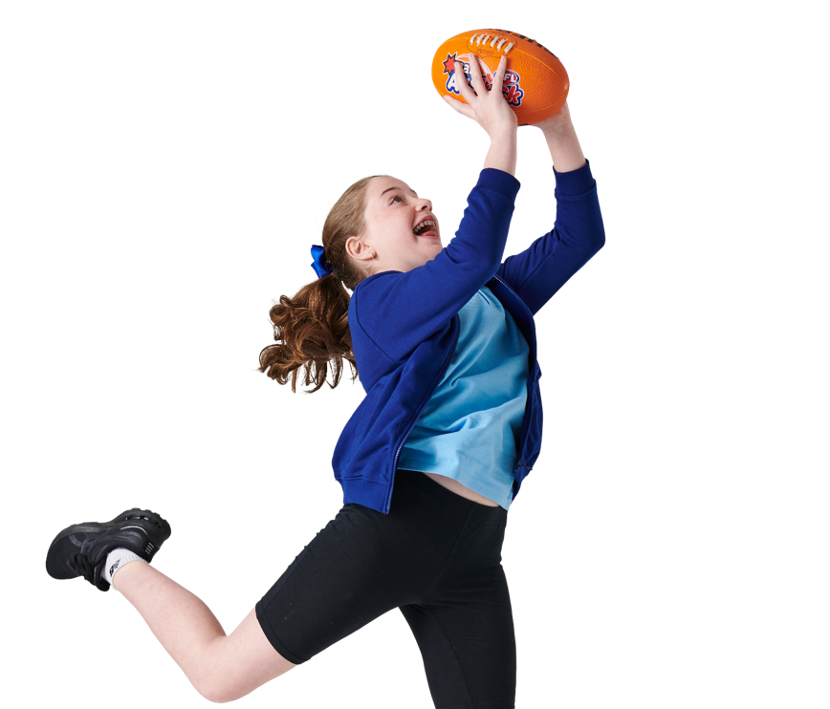




INTERACTIVE RESOURCE PACK
YEAR 5-6

Slide 2


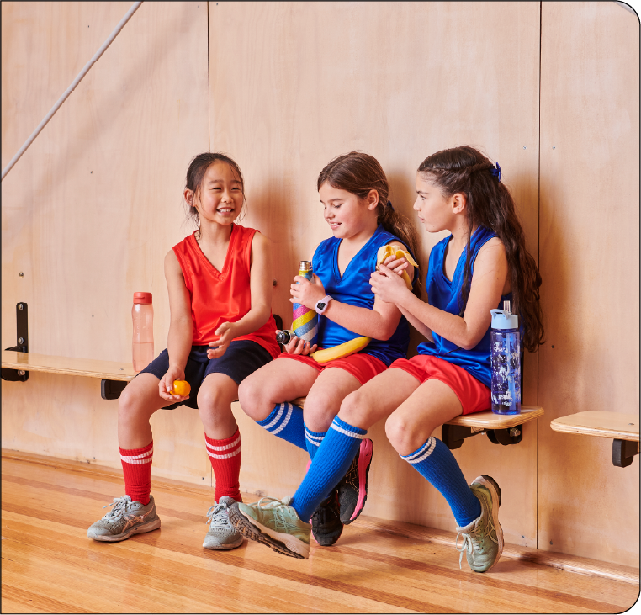
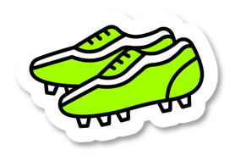
CONTENTS
Lesson 1:
Nutritional health
Lesson 2:
Sustainable farming
Lesson 3:
Time to plan our garden
Lesson 4:
Sustainable food practices
Lesson 5:
Garden design presentations

Slide 3
AUSTRALIAN RULES FOOTBALL BALL SKILLS
Tags and Tails | 2 bibs (or ribbon, sashes, etc), 2 footballs. Spread students out over the playing area. Two students wear a bib: they are the ‘taggers’. Two other students have a football: they are the ‘handball magicians’. The bibbed taggers chase anyone without a ball and tag them with their hand. When a student gets tagged, they freeze with hands in the air. They are to call out to a handball magician. Once the handball magician sees their hands in the air - as a signal for help - they must come to free them. Students become ‘unfrozen’ when the handball magician handballs to the frozen student who must mark and then handball back to the magician. Both can now keep playing. To keep everyone involved, change taggers and handball magicians a number of times. Modified version Change how feet get unfrozen or how students move around. Change the rules so that the frozen students become the handball magician once they are freed. Try having students bounce the football on the ground every few steps.
Gates | 1 football per pair, collection of cones. Create ‘gates’ in the playing area by using two cones of the same colour placed a metre apart. There should be at least one gate for every student pair. When you say ‘Go’, each pair handballs to each other three times, through their gate, then runs to a vacant gate and performs three more handballs. Repeat. If you have enough different coloured cones, have a race to see which students can visit every different coloured gate. Modified version Have students just handball to each other through the gate. After a pair handballs three times, have the student without the ball run to another gate and find a new partner. Swap this rule after a while so that the student with the ball leaves. Students with the ball must bounce while running to a new gate.

Slide 4

AUSTRALIAN RULES FOOTBALL BALL SKILLS
Chase the Bouncer | 1 football per student, collections of cones or markers. Use the cone to create 10m x 10m squares within your playing area. Split students into pairs. Give one student in the pair the football and have them stand by a cone. They are the 'bouncer'. The other student stands at the diagonally opposite cone, they are the 'tagger'. Try to avoid having more than one student on a cone - so make as many squares as you need for your group. When you say ‘go’, the student with the ball runs around the edge of the square, bouncing the ball on each side of the square. The chaser attempts to catch the bouncer and tag them. Swap roles. Modified version Rather than one student tagging the other, both students could run around the square at the same time just bouncing the ball. Try having students take two bounces on each side of the square, or even three. You can also try playing threes instead of pairs. Have the extra student on the inside of the square next to the bouncer, giving and receiving handballs after each bounce.
Escape the Chaos | 1 football per pair, collection of cones. Lay your cones out inside a square (recommended 15m x 15m). Divide students into two teams. The first team stands inside the square playing area while the second team stands outside. Students inside the square start with a football. When the teacher says ‘Go!’ students on the inside of the square handball their football to a student on the outside,(who takes the mark) then run out of the square waiting to receive a different football. Once the outside student receives the football, they run into the square, then handball back out. Repeat. Try having students inside the square place their ball on the ground, then run and gather a different football before handballing to the outside. Modified version Reverse it by having students on the outside of the square starting with the ball. They handball to students on the inside, who take the mark and run to the outside. Try taking a bounce before handballing or including a defender within the playing area.

Slide 5
AUSTRALIAN RULES FOOTBALL BALL SKILLS
Footy Tag | 1 football per student, Bibs, a stack of cones Inside a square (recommended 10m x 10m) each student starts with a football. Two students wear a bib and stand in the centre as defenders. On ‘Go!’ students run around the square evading the defenders. When a defender tags a student, that student must stop and stand still holding the football above their head, and with their legs apart. An untagged student must handball their football through the legs of the tagged student and regather the football. The tagged student is now free. After a designated time, swap the defenders. Modified version Increase the amount of defenders. Students must bounce the ball every 10 steps. Swap handballing through legs to handballing to a tagged student. The tagged student must mark and release cleanly to be freed.
Collect the Coins | Footballs (up to 20), a collection of cones. Place cones on each corner of the activity square. These are the team bases. Set up a small circle of cones in the middle and put all the footballs inside. This is the Ruckman’s Treasure! Divide the students into four groups. Each group starts at one of the bases. On ‘Go!’, one student from each group tries to steal a ball from the ‘Ruckman’s Treasure’ and run it back to their team without being caught. After the first student has made it back, the next teammate has a go. The Ruckman stops balls from being stolen by tagging the student while they are holding the ball. The ball goes back to the centre and the tagged student returns to their team. If the centre circle is empty, students can start stealing balls from other groups. If they get tagged by an opponent while holding a ball, they return that ball back to the centre circle. Modified version Have students bounce the ball as they run. When grabbing a ball from the centre or stealing from rival groups, students can try rolling, handballing, or kicking the ball back to their group.

Slide 6
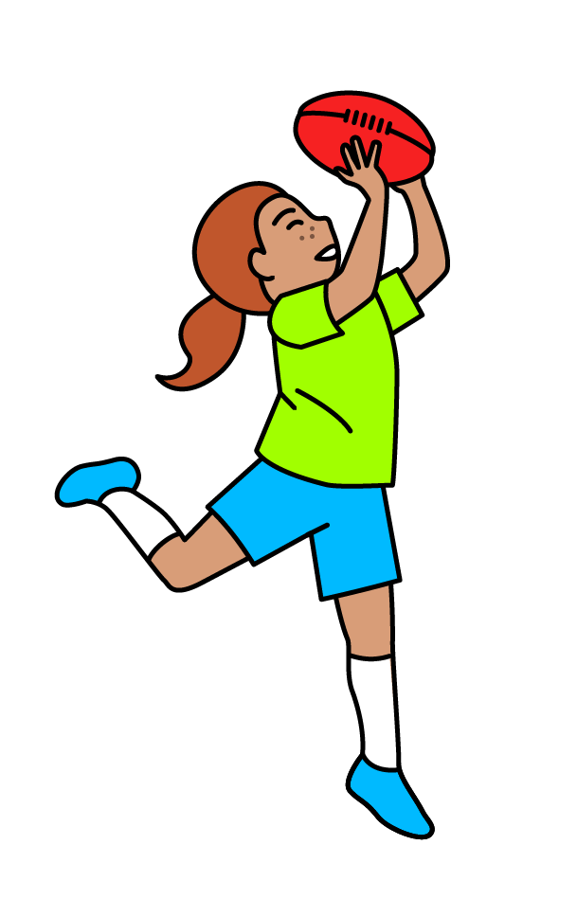

CHK VIDEOS : THE FIVE FOOD GROUPS

Slide 7
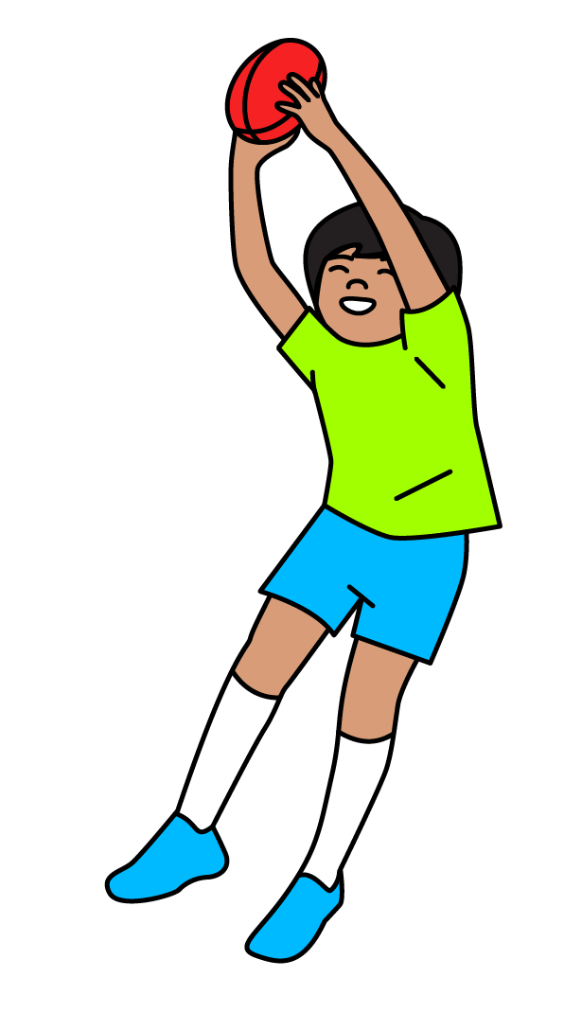
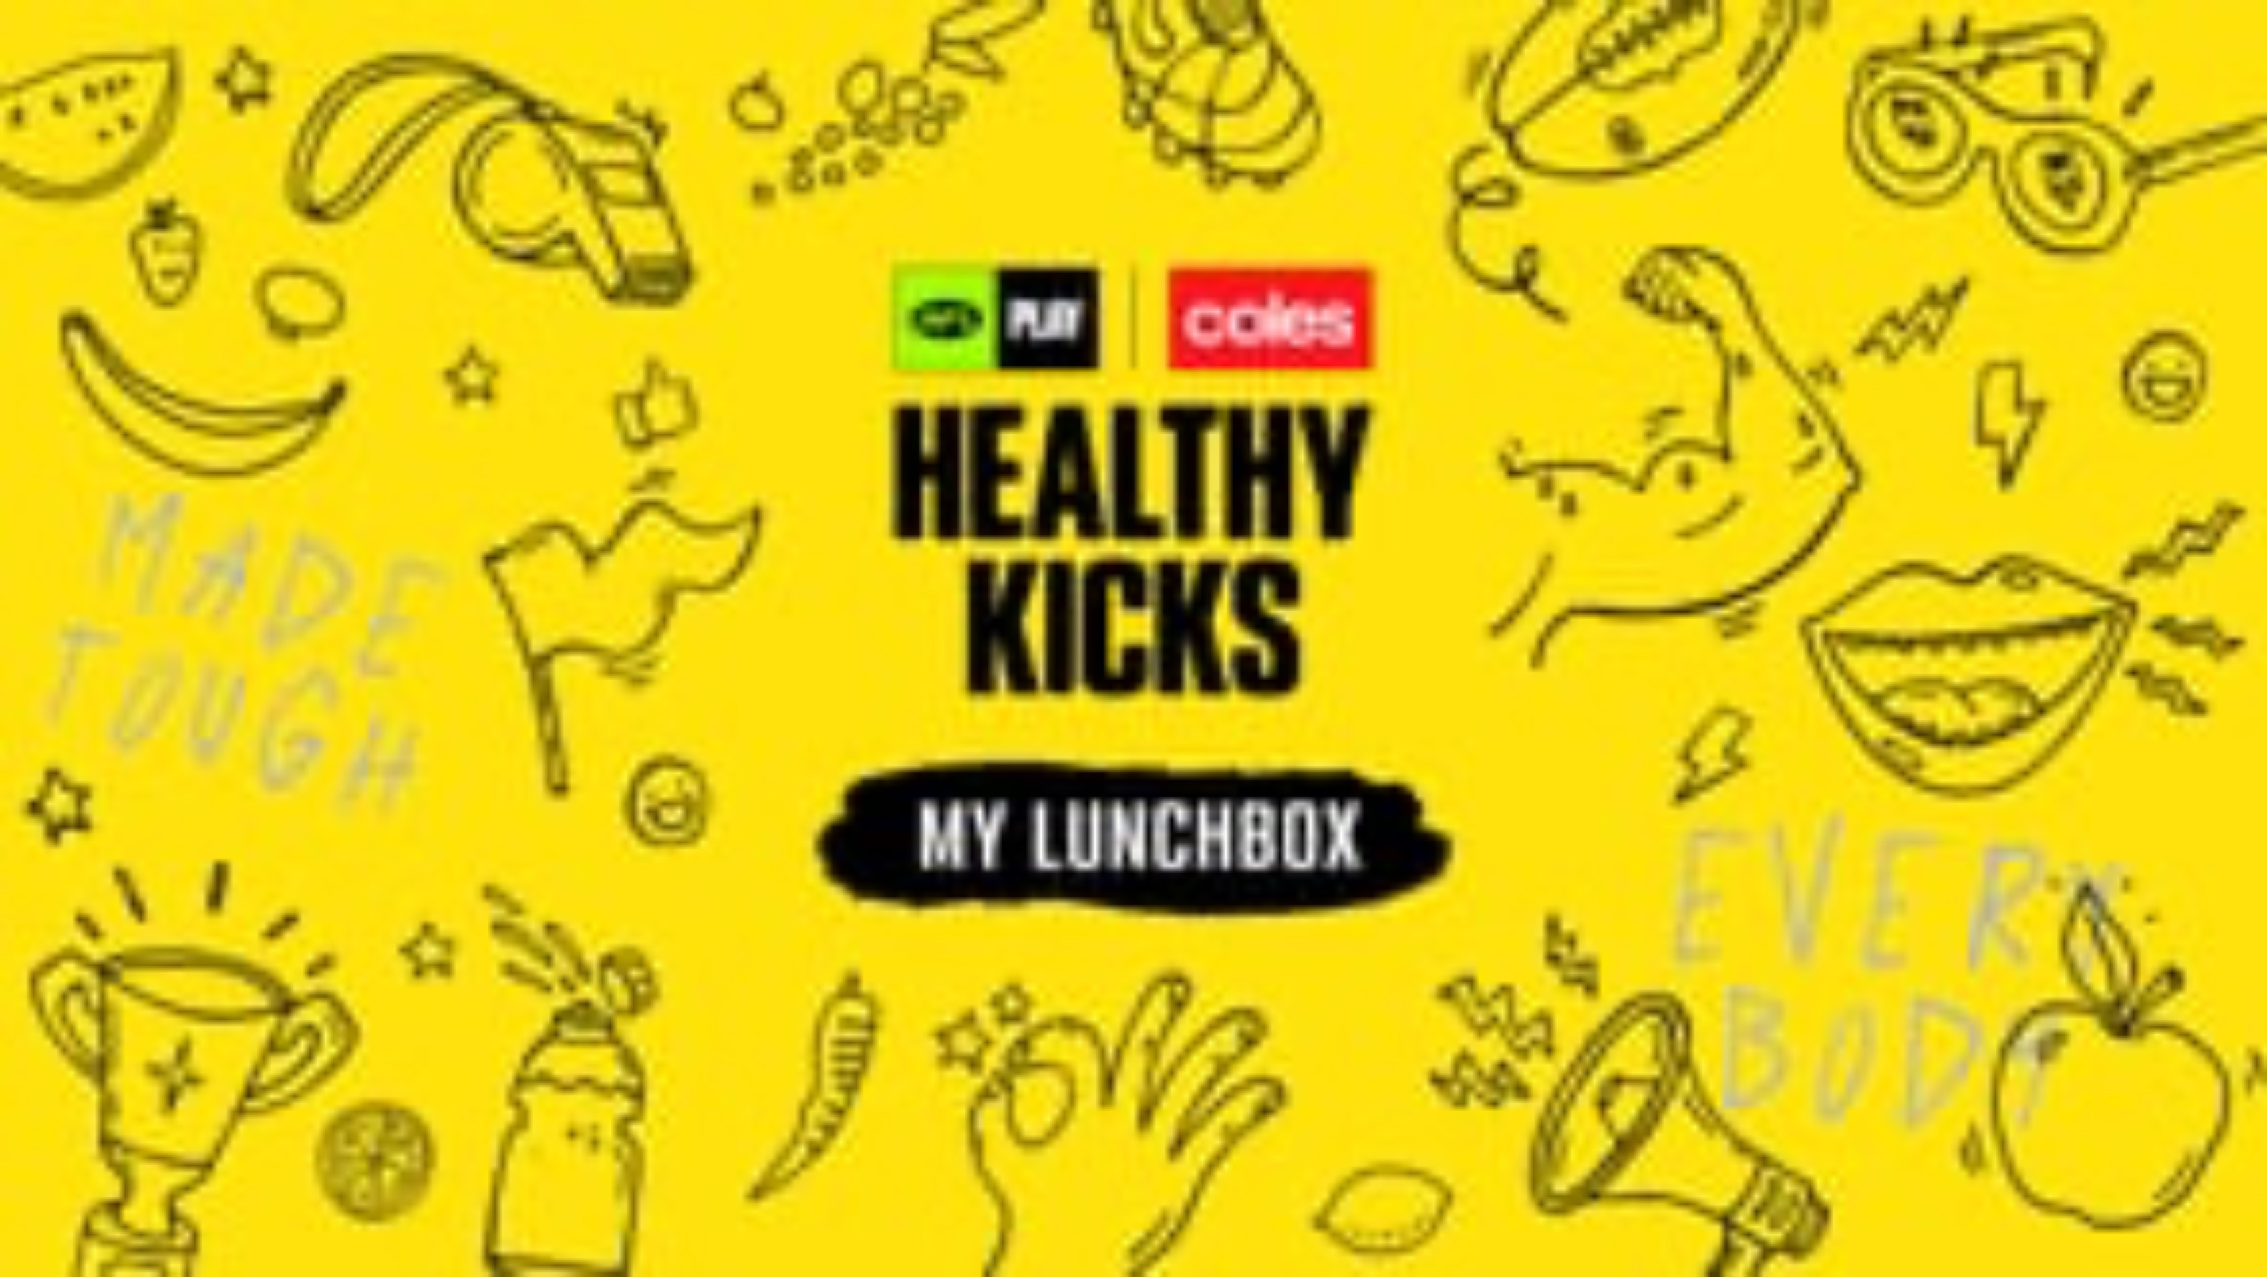
CHK VIDEOS : MY LUNCHBOX

Slide 8

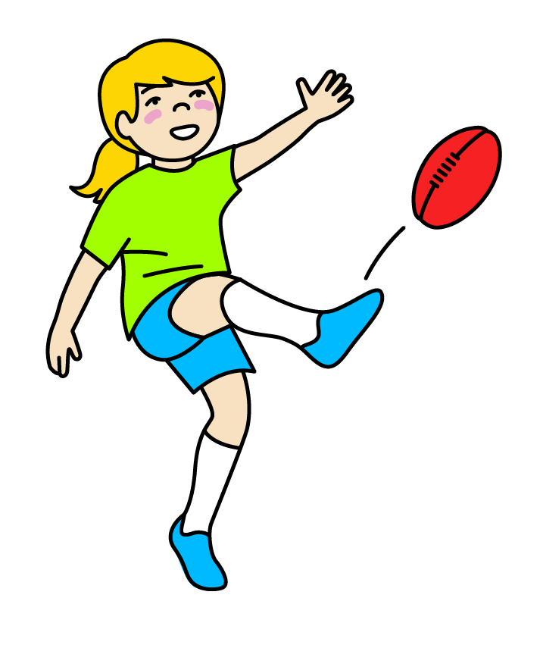
CHK VIDEOS : FUELING OUR BODIES

Slide 9

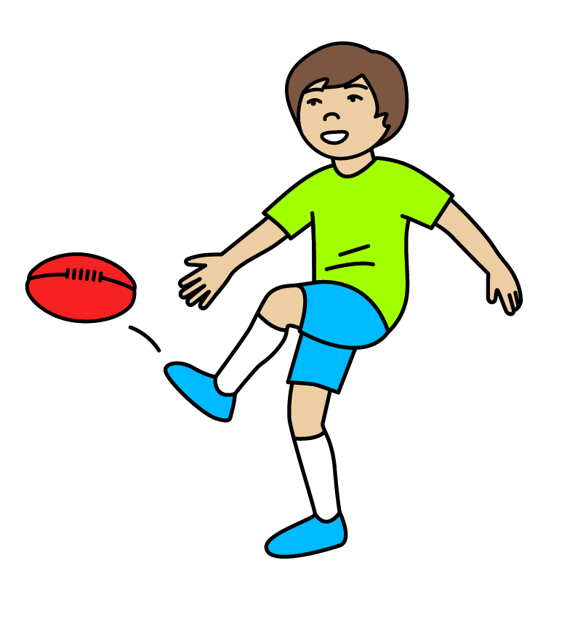
CHK VIDEOS : FOOD AND CULTURE

Slide 10

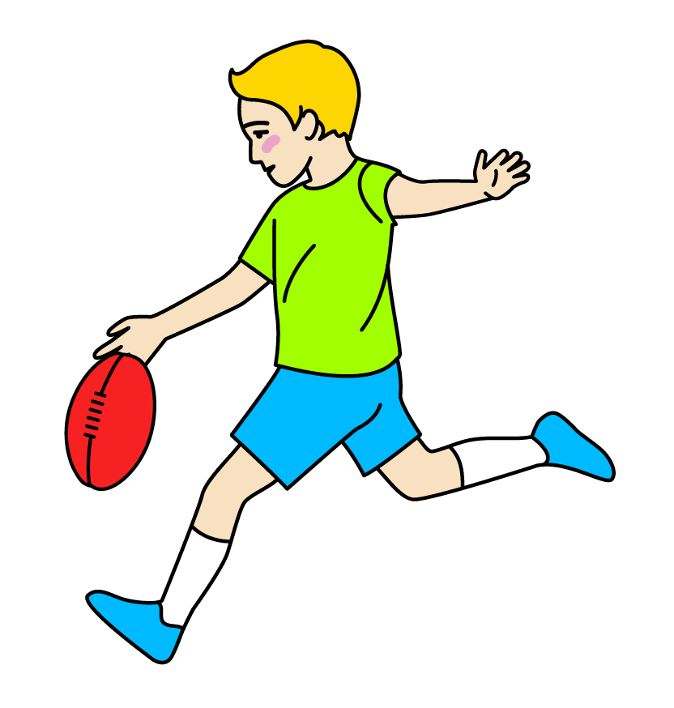
CHK VIDEOS : HYDRATION

Slide 11
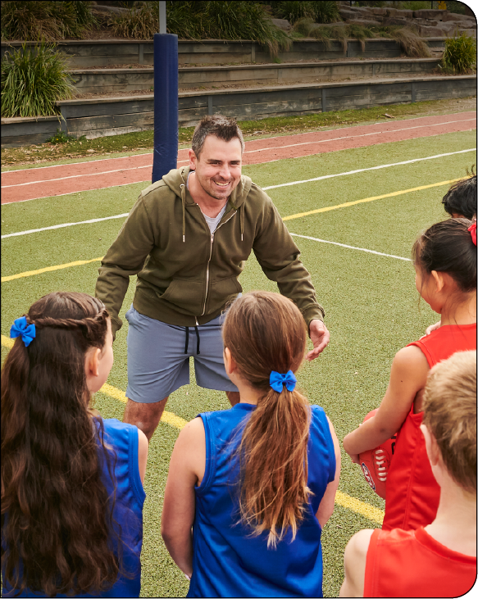

LESSON 1: NUTRITIONAL HEALTH
Learning intention
In this lesson, we will focus on the importance of mobility and stretching and analyse nutritional information on food packaging. Additionally, we will define the key elements and design thinking steps for our garden design challenge.
Success criteria
I will know I am successful when I can:
Participate in mobility and stretching exercises.
Identify a benefit of doing mobility training.
Identify a consequence of not doing mobility training.
Interpret nutritional information on food labels.

Slide 12
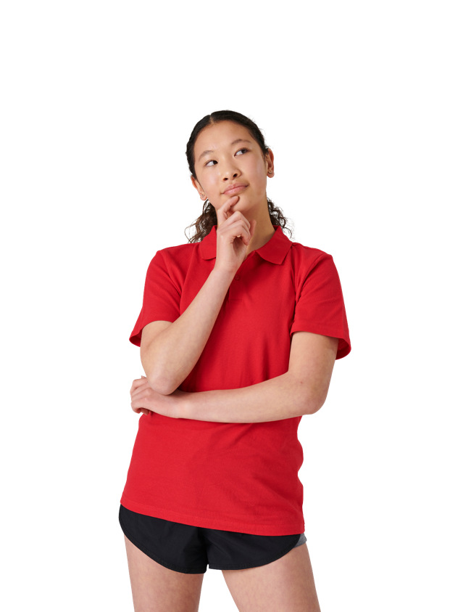


GUIDING QUESTIONS
GUIDING QUESTIONS
Why is it important to be active; make nutritional and healthy food choices; and follow sustainable practices for our overall health and wellbeing?
How do you feel when you are playing
footy or doing exercise?
What are the benefits of mobility training versus the consequences of not doing mobility training?
How do you feel when you are playing
footy or doing exercise?
How does mobility assist AFL players with their performance?
How do you feel when you are playing
Why is it important to read and understand food labels?
How do you feel when you are playing

Slide 13
VOCABULARY
Extra ingredients added to food or products to improve their taste, appearance, or shelf life.
Things that can cause an allergic reaction in some people, like certain foods, pollen, or dust.
ADDITIVES
ALLERGENS
A good thing or advantage that helps someone or something.
COLLABORATE
BENEFIT
To work together with others to do something.
The result or effect of something that has happened, often because of a choice or action.
A limit or rule that stops someone from doing something or makes it harder to do something.
CONSEQUENCE
CONSTRAINT
ENHANCE
To make something better or improve it.

Slide 14
VOCABULARY
A strong, stretchy, connective tissue in your body that covers and holds muscles, bones, and organs in place. It allows different parts of your body to move smoothly.
FASCIA
The ability to change or bend easily, or being able to adapt to different situations.
FLEXIBILITY
MOBILITY
The way food helps your body grow strong and healthy. Different kinds of food help our body in different ways.
The ability to move easily from one place to another.
NUTRITION
Something that can be used or done in a way that doesn't harm the environment and can continue for a long time without running out or causing damage.
POSTURE
SUSTAINABLE
How you sit or stand.
Can you think of any other words that might be important?

Slide 15

KWL
Why do we need to play, move and eat healthy foods to help our body feel strong and happy?
K - What I know
W - What I want to know
L - What I learnt

Slide 16
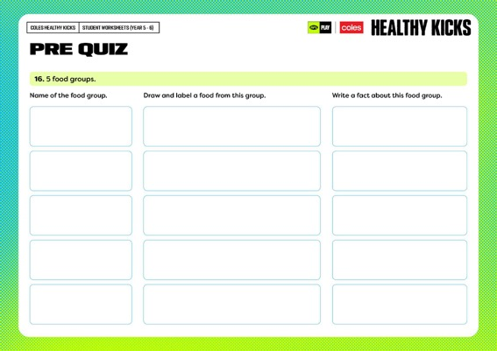
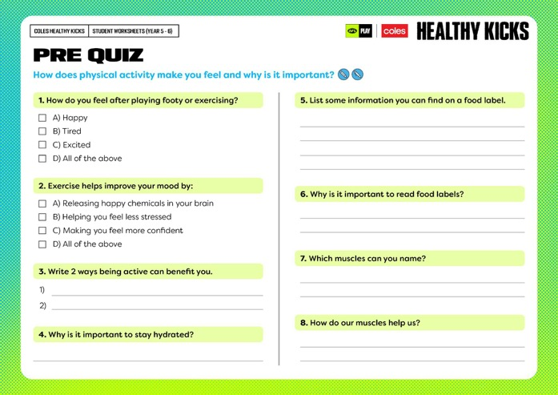
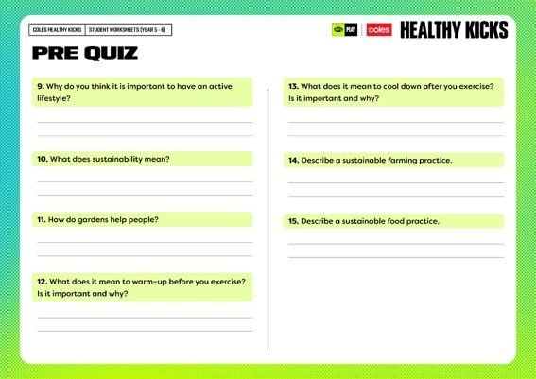


Slide 17
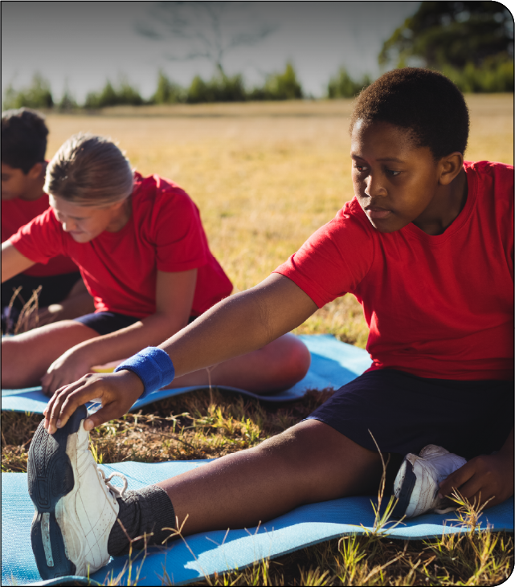
LET’S KEEP IT MOBILE
What is mobility training?
Mobility training focuses on moving your body in different ways to improve how your muscles and joints work together.
Mobility training often focuses on specific areas of the body like the hips, shoulders, or spine.
It can include:
Stretching: to warm up the body before exercise and improve flexibility.
Joint rotations: controlled rotations of joints to promote fluid movement and stability.
Foam rolling: to release tight muscles and fascia.
Strengthening: building muscle strength in ranges of motion that improve mobility.
Breathing exercises: using breath control to deepen stretches and relax muscles.

Slide 18
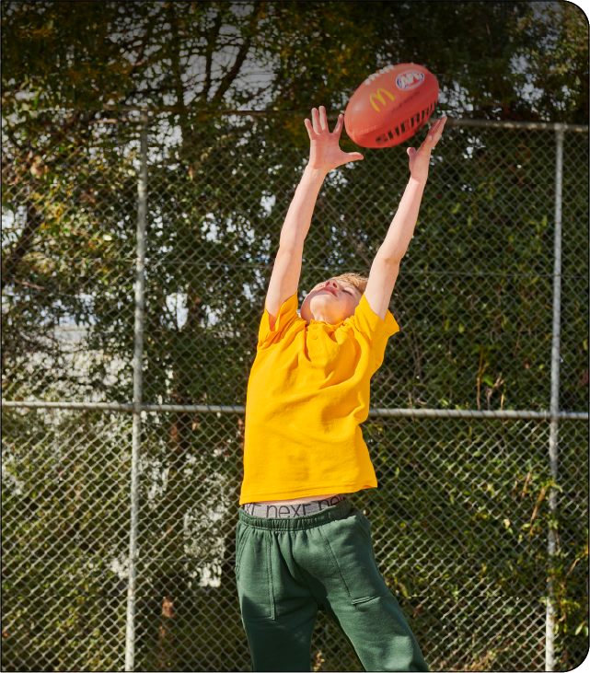

LET’S KEEP IT MOBILE
Benefits of mobility training
Improved flexibility: increases the range of motion in your joints and muscles.
Reduced injury risk: keeps muscles and joints flexible, preventing strains and sprains.
Better posture: helps correct muscle imbalances, improving overall posture.
Enhanced performance: allows for more efficient movement in sports and daily activities.
Less pain: eases tightness and reduces chronic pain, especially in areas like the back and hips.
Improved balance and stability: boosts body control, making it easier to maintain balance and coordination.

Slide 19
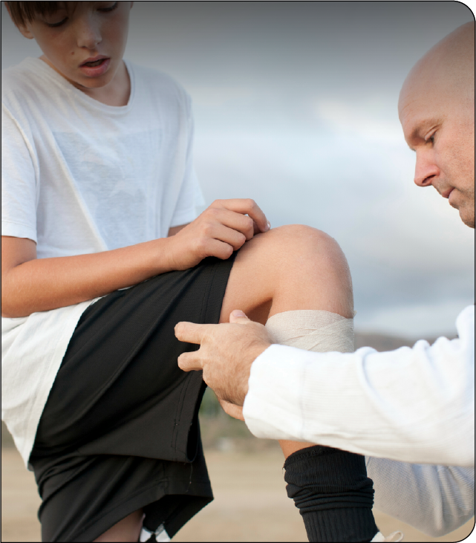

LET’S KEEP IT MOBILE
Consequences of not doing mobility training
Stiffness: limited movement and difficulty with everyday tasks.
Increased injury risk: tight muscles and joints can cause strains and sprains.
Poor posture: muscle imbalances leading to discomfort.
Lower performance: reduced efficiency in movement and exercise.
Chronic pain: ongoing pain, especially in the back, hips, and shoulders.
Poor balance: decreased coordination and stability.

Slide 20
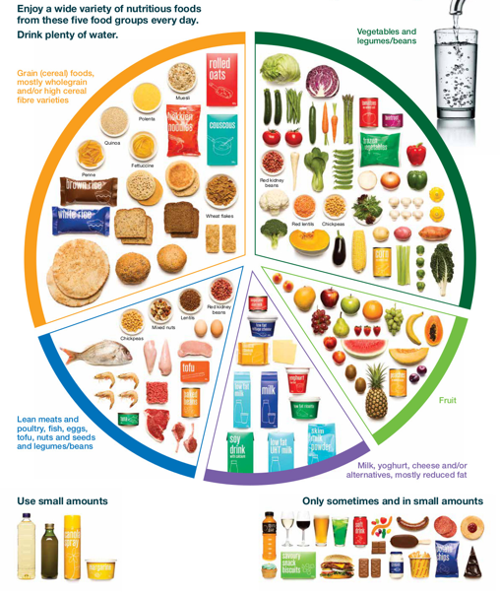
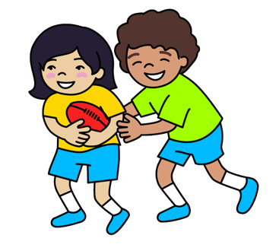
AUSTRALIAN GUIDE TO HEALTHY EATING
Use the information on the Australian Guide to Healthy Eating to discuss and investigate recommended nutritional information.
https://www.eatforhealth.gov.au/food-essentials/five-food-groups
What are the 5 food groups?
What are the key nutrients of the different food groups?
What does Guideline 2 of the Australian Guide to Healthy Eating recommend?

Slide 21

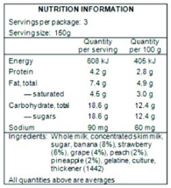
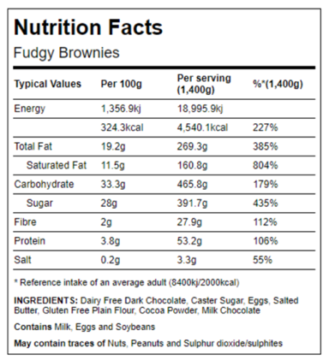
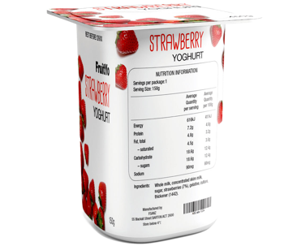
QUIZ: CAN YOU READ A LABEL
Do you know what these food label features mean?
The health star rating on food tells you how healthy foods are - the more stars the healthier it is.
How can our garden encourage us to make healthy food choices?
The nutrition information panel lists information about protein, fats and other content. The information shows average serving size and per 100 gram.
How can our garden encourage us to make healthy food choices?
Food additives must be listed on labels. They can look like this: Colour (Caramel l), Colour (150a).
How can our garden encourage us to make healthy food choices?
The ingredients list tells you what is in the product. The ingredients are listed from greatest to smallest by weight.
How can our garden encourage us to make healthy food choices?
Allergens like nuts and eggs, must be listed on food labels.
How can our garden encourage us to make healthy food choices?
https://www.foodstandards.gov.au/consumer/labelling

Slide 22
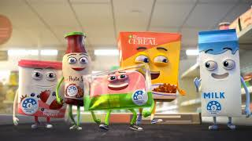

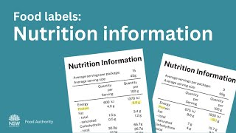
FOOD LABELS: WHAT DO THEY TELL US?
Health Star Rating
Reference: Australian Department of Health and Aged Care
Food labels: Ingredients lists
Reference: NSWFoodAuthority
Food labels: Nutrition information
Reference: NSWFoodAuthority

Slide 23
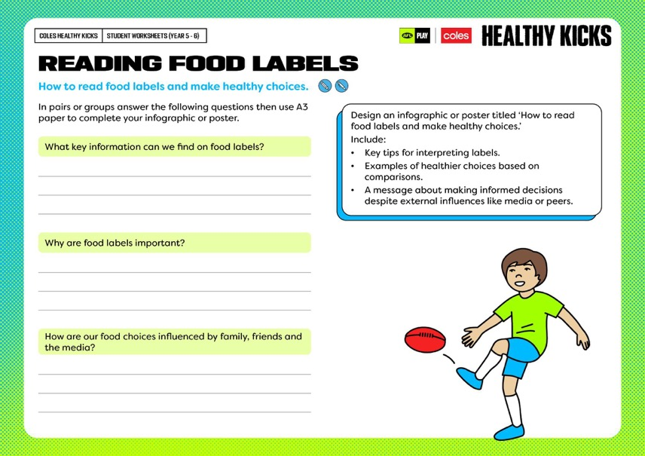
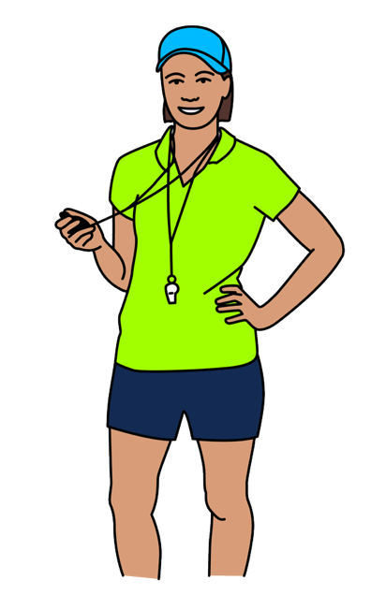
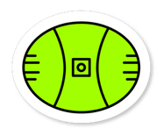

Slide 24
RESULTS FROM OUR CLASS QUESTIONNAIRE
What do you currently do in your life to be healthy? | What things help you do this? | What do you currently do in your life to be active? | What things help you do this? | Do you have a garden at home? | Do you think we need a school garden? Why or why not? | How could a garden help us to lead a healthy lifestyle? | If an AFL Club had a garden, what types of foods do you think they would grow?

Slide 25
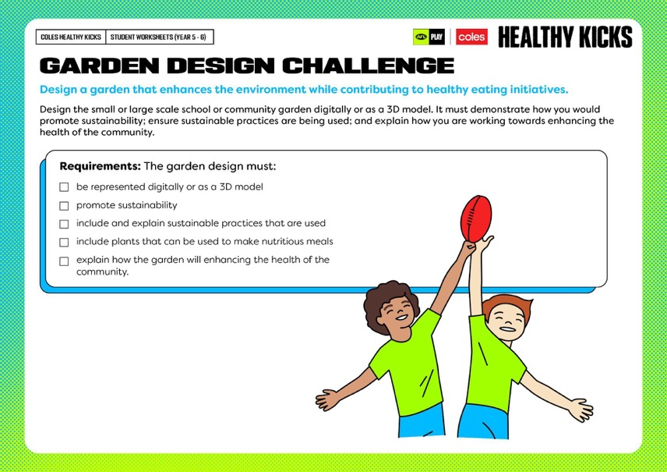

Slide 26






GARDEN DESIGN CHALLENGE
Design a garden that enhances the environment while contributing to healthy eating initiatives.
1.
ASK
2.
IMAGINE
PLAN
3.
What’s the problem?
Brainstorm!
Choose a solution.
Draw it!
Make a materials list.
4.
CREATE
5.
IMPROVE
Make it!
Try it out.
Make it better!

Slide 27
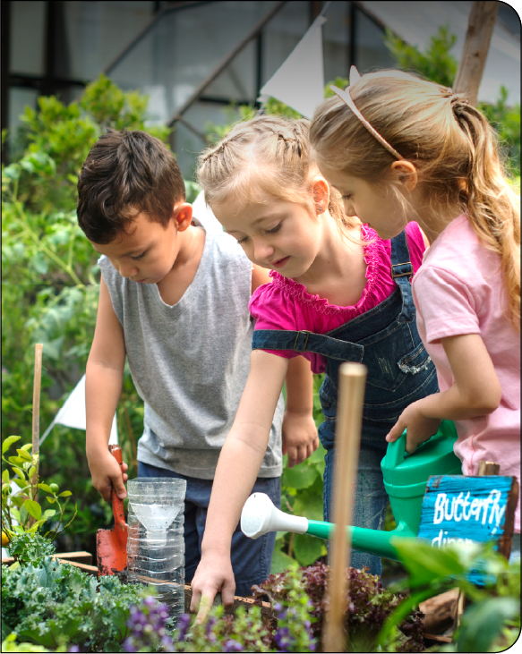


GARDEN DESIGN CHALLENGE
Design a garden that enhances the environment while contributing to healthy eating initiatives.
1.
ASK
What’s the problem?

Slide 28
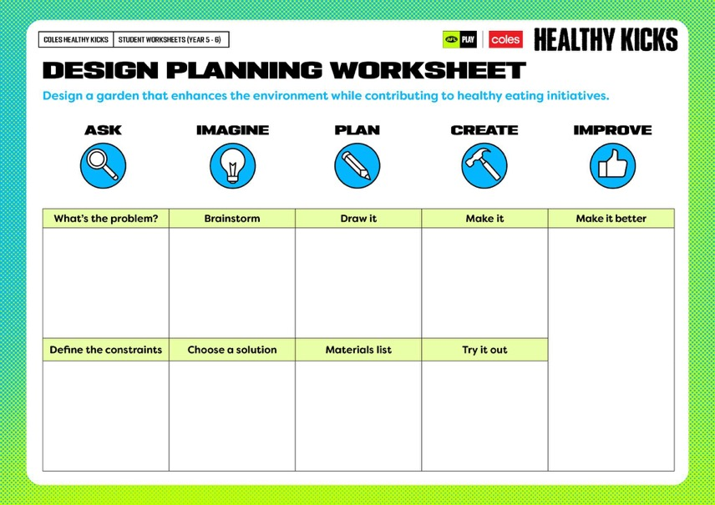
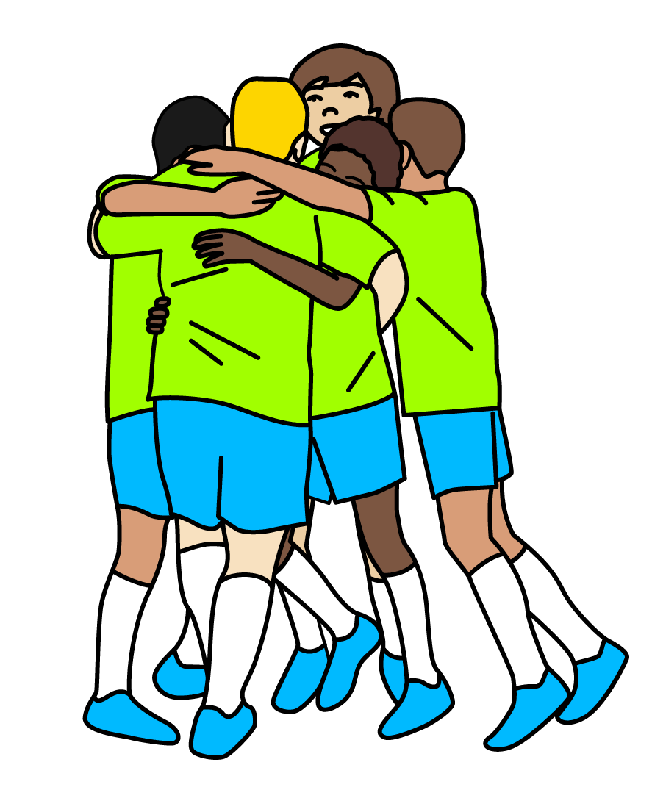


Slide 29
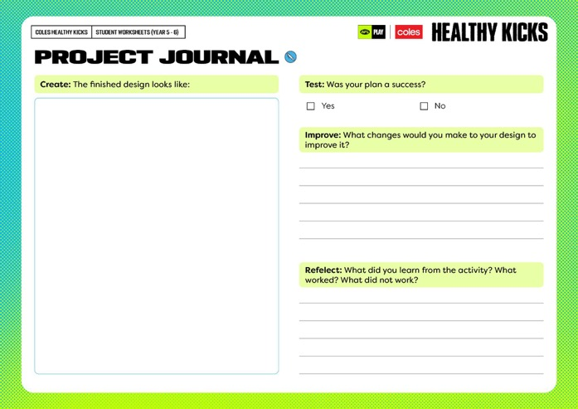
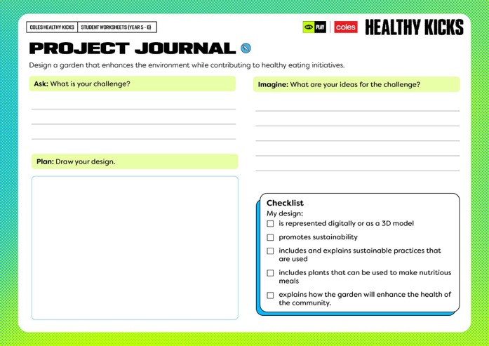

Slide 30
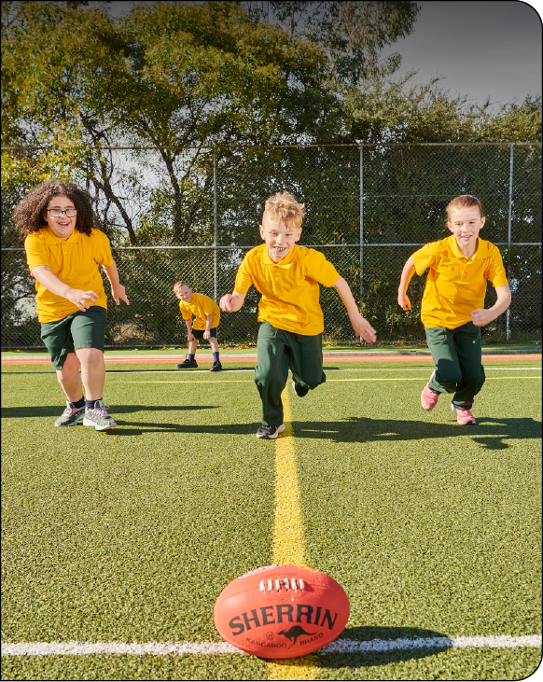

LESSON 2: SUSTAINABLE FARMING
Learning intention
In this lesson we will learn why building strength is important, not only for our bones and muscles but to help our overall motor skills and our self confidence. We will learn about sustainable farm practices and explore ways we can use our new knowledge in our garden designs.
Success criteria
I will know I am successful when I can:
Participate in warm-up and cool down strength activities
Discuss why building strength is important for physical and mental wellbeing
Implement sustainable farming knowledge into our garden design.

Slide 31

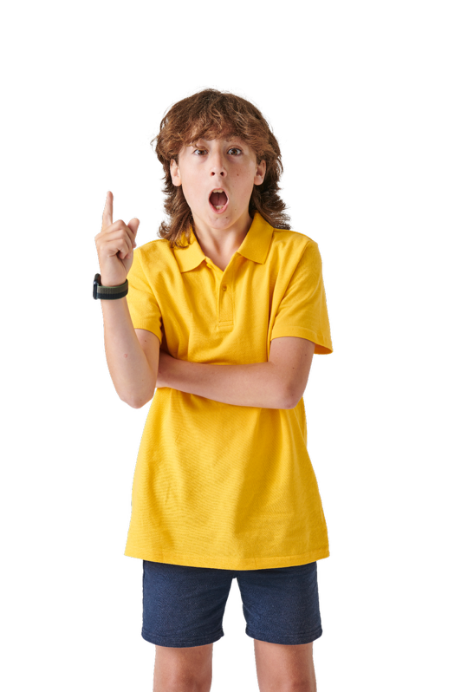
GUIDING QUESTIONS
GUIDING QUESTIONS
How do different muscle groups affect our overall health and wellbeing?
How do you feel when you are playing
footy or doing exercise?
Which muscles do you think are most important for AFL players?
How do you feel when you are playing
footy or doing exercise?
What are some sustainable farm practices we can use in our garden design?
How do you feel when you are playing
footy or doing exercise?

Slide 32
VOCABULARY
The practice of growing crops and raising animals for food, clothing, and other products.
Relating to the heart. For example, ‘cardiac health’ means the health of your heart.
AGRICULTURE
CARDIAC
Officially recognised as meeting certain standards or rules, usually after a test or review.
The ability to keep doing something for a long time without getting tired or giving up.
CERTIFIED
ENDURANCE
Following rules about what is right and wrong, and treating people and animals fairly.
A very skilled or top-level athlete who performs at the highest level in their sport.
ETHICAL
ELITE ATHLETE

Slide 33
VOCABULARY
The process by which your body turns food into energy. It helps your body grow, stay healthy, and perform everyday tasks.
Tissues in the body that help you move. They contract (get shorter) and relax (get longer) to make your body move.
METABOLISM
MUSCLE
When materials or products are obtained in a way that is good for the environment and respects people’s rights, such as ensuring fair working conditions and protecting natural resources.
RESPONSIBLY SOURCED
Related to the skeleton, which is the structure of bones in your body that supports you and protects your organs.
SKELETAL
Taking care of our planet so that people in the future can also enjoy it. It means being kind to nature and using things carefully.
Can you think of any other words that might be important?
SUSTAINABILITY

Slide 34
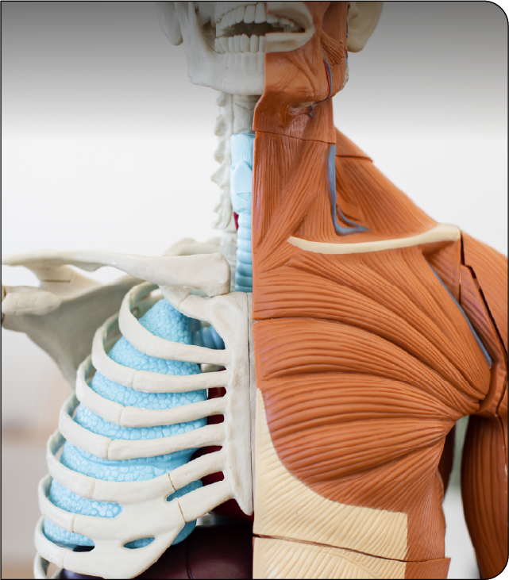

OUR MUSCLES - DID YOU KNOW?
How do different muscle groups affect our overall health and wellbeing?
Types of muscles
Skeletal Muscles:
These are the muscles attached to bones that allow us to move. They are under voluntary control, which means we can decide when to use them.
Smooth Muscles:
Found in organs like the stomach and intestines, smooth muscles are involuntary (we cannot control them consciously).
Cardiac Muscles:
These muscles make up the heart and work automatically to keep the heart pumping blood.

Slide 35
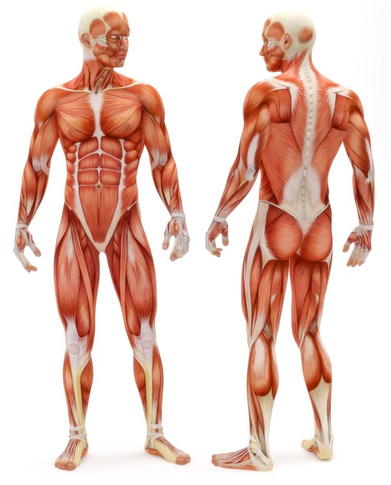

OUR MUSCLES - DID YOU KNOW?
Main muscle groups
Leg Muscles:
Quadriceps: Straighten the knee.
Hamstrings: Bend the knee.
Calf Muscles: Help you stand on your toes and walk.
Core Muscles:
Abdominals: Support the trunk and help with bending and twisting.
Obliques: Help with side bending and rotation.
Lower Back: Support the spine and help with movement.
Arm Muscles:
Biceps: Bend the elbow.
Triceps: Straighten the arm.
Forearms: Control hand and finger movement.
Chest and Back Muscles:
Pectorals: Help with arm and shoulder movements.
Latissimus Dorsi: Support the spine and move arms.

Slide 36
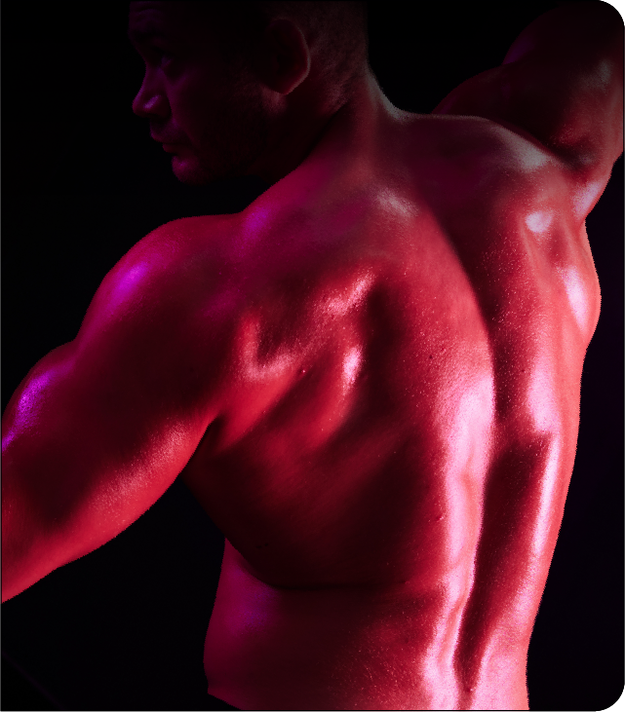

OUR MUSCLES - DID YOU KNOW?
Muscles and health
Movement:
Muscles help us move and stay active.
Balance and Posture:
Strong muscles keep us upright and balanced.
Strength and Endurance:
Exercise makes muscles stronger and more durable.
Heart Health:
Muscles, like the heart, help with circulation and oxygen flow.
Flexibility:
Stretching improves flexibility and reduces injury.
Metabolism:
Muscles help burn calories and manage weight.

Slide 37
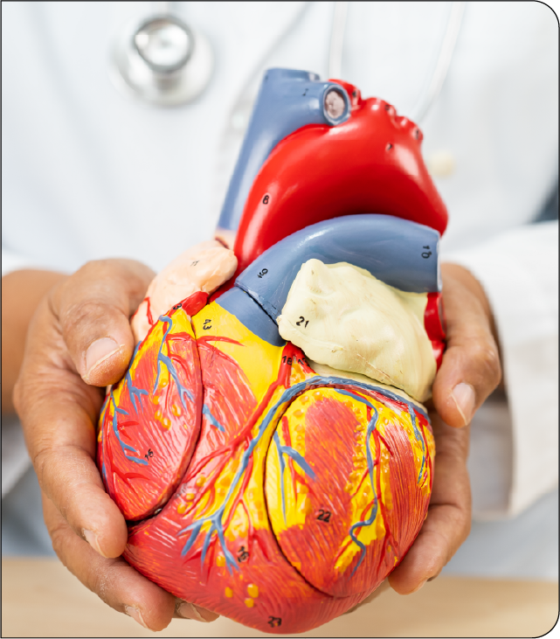
OUR MUSCLES - DID YOU KNOW?
Did you know?
There are 640 muscles in the body.
We use 200 muscles to take a step forward.
Your heart is your hardest-working muscle. On average it takes 80,000 to 100,000 beats each day.
Gluteus maximus otherwise known as your bottom is the biggest muscle in the body.
The longest muscle in the body is the sartorius muscle (hip/groin to hip).
We have four muscles in the quad (thigh) muscle alone.
Muscles are crucial for moving, staying strong, and maintaining a healthy body. Strength training is important because it strengthens bones and muscles, protects the joints, improves motor skills and builds self-confidence.

Slide 38
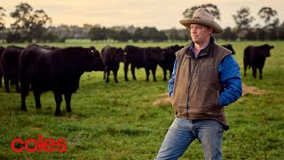
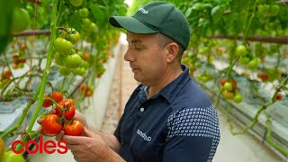
COLES SUSTAINABLE FARMING
What are 5 facts you have learnt about sustainable farming from this video?
What are 5 facts you have learnt about sustainable farming from this video?
1.
2.
3.
4.
5.
1.
2.
3.
4.
5.

Slide 39
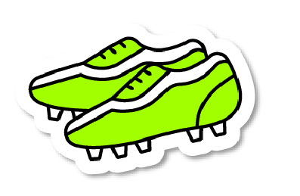
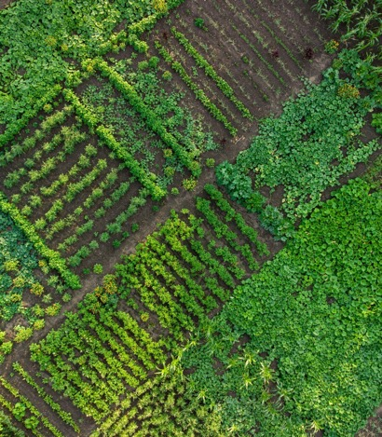
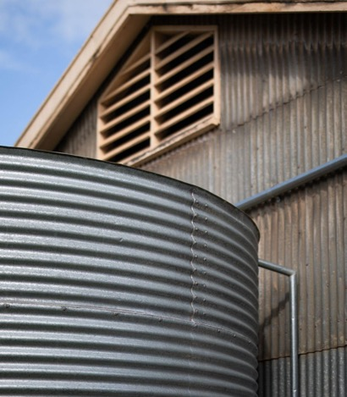
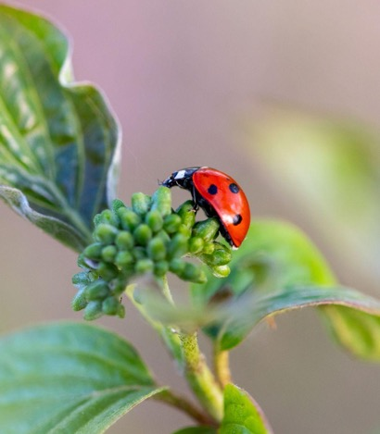
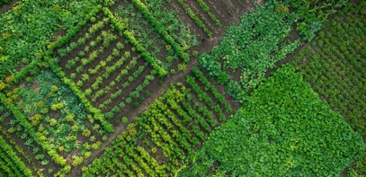
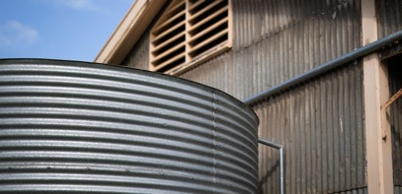
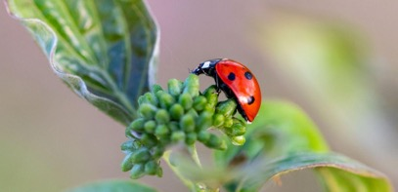
SUSTAINABLE FARMING
Sustainable farming is when you grow food in a way that takes care of the land and the resources we need so that it’s good for the Earth now, and for everyone in the future.
CROP ROTATION WITH MULCHING
RAINWATER HARVESTING
CROP ROTATION WITH MULCHING
CROP ROTATION WITH MULCHING
RAINWATER HARVESTING
BIOLOGICAL PEST CONTROL
Sustainable farming takes care of the soil by planting different things together and leaving leftover plant parts on the ground. This makes the soil super rich, so plants can grow big and strong.
Sustainable farmers collect rainwater. This means that during times of drought they are able to water the crops.
Sustainable farmers use natural ways to keep bugs and insects away from the crops. This can include planting special flowers that attract good bugs to eat the bad ones.

Slide 40
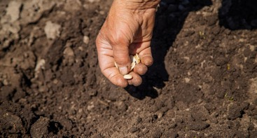
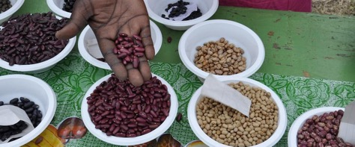

SUSTAINABLE FARMING
Aboriginal communities have used sustainable farming practices for thousands of years. Drawing on traditional knowledge and connection to the land they use techniques that promote biodiversity and respect for the land.
SEASONAL PLANTING
SEED SAVING AND EXCHANGE
CONTROLLED BURNING
Fruits and vegetables are planted according to the seasons. They plant their crops at the right time of year, so they grow well without needing lots of extra help.
Many Aboriginal communities have a tradition of saving seeds from their harvests and exchanging them with other community members. This helps preserve local plant varieties and makes them more resilient to pests, diseases, and changing environmental conditions.
Controlled burning is a traditional practice used by many Aboriginal communities. It helps certain plants, grow better, regenerates soils and reduces the risk of bushfires.

Slide 41

THINK PAIR SHARE
THINK PAIR SHARE
What are some sustainable farm practices we can use in our garden design?
How do you feel when you are playing
footy or doing exercise?
How can our garden encourage us to make healthy food choices?

Slide 42

GARDEN DESIGN CHALLENGE
Design a garden that enhances the environment while contributing to healthy eating initiatives.
In your design groups:
research and investigate how you could represent your garden as a 3D model or digitally.
complete the ‘Imagine’ section of the design process worksheet.
remember to include sustainable practices in your design.
2.
IMAGINE
Brainstorm!
Choose a solution.

Slide 43

LESSON 3: TIME TO PLAN OUR GARDEN
Learning intention
In this lesson, we will develop an understanding of the importance of cardiovascular training and create a fun activity circuit. We will explore how sustainable gardening benefits not just for the environment, but also our overall health and wellbeing. We will start to plan our garden design.
Success criteria
I will know I am successful when I can:
Participate in cardiovascular activities.
Identify the effects exercise has on has on our mental and physical health.
Identify the mental, physical, and social benefits of gardening.
Work collaboratively on our garden design.

Slide 44



GUIDING QUESTIONS
GUIDING QUESTIONS
How does physical activity benefit our health and mental wellbeing?
How do you feel when you are playing
footy or doing exercise?
What are the mental, physical, and social benefits of gardening?
How do you feel when you are playing
footy or doing exercise?
How can we represent sustainable agriculture practices in a 3D or digital garden design?
How do you feel when you are playing
footy or doing exercise?

Slide 45
VOCABULARY
A way of designing buildings and spaces that connects people with nature. This includes using natural materials, plants, sunlight, and views of nature to make spaces healthier, more comfortable, and calming.
BIOPHILIC DESIGN
Relates to your heart and blood vessels that carry blood around your body.
CARDIOVASCULAR
A group of people who live in the same area or share common interests, values, or goals. They often work together to help each other and make their surroundings better.
It is when your body doesn’t have enough water, and you can feel thirsty or tired.
COMMUNITY
DEHYDRATION

Slide 46
VOCABULARY
The science and practice of growing plants, especially fruits, vegetables, flowers, and trees. It involves taking care of plants to make them grow healthy and strong.
HORTICULTURE
The process of taking in enough water to keep your body healthy and working properly.
HYDRATION
The state of your emotional, psychological, and social well-being. It affects how you think, feel, and act, and helps you handle stress, relate to others, and make choices.
MENTAL HEALTH
Can you think of any other words that might be important?

Slide 47

LET’S STAY ACTIVE!
How does physical activity benefit our health and mental wellbeing?
Keeps our body strong: Physical activity, like running or playing sports, makes our muscles and bones stronger. It helps our heart and lungs work better, so we can feel more energetic and healthy.
Boosts mood and happiness: When we exercise, our brain releases special chemicals that make us feel happier. It can help reduce stress and make us feel less worried or sad.
Improves sleep: Being active during the day helps us sleep better at night. When we sleep well, our brains and bodies get the rest they need to be healthy.
Builds confidence: Physical activity helps us achieve goals, like learning a new sport or improving our strength. This makes us feel proud of ourselves and boosts our confidence.
Helps us focus and learn: Exercise increases blood flow to our brain, which helps us concentrate better in school and remember things more easily. It makes learning easier and more fun!
Exercise does not necessarily have to be hard, it is important to find something that you enjoy to make it fun and keep you motivated to participate. It might be riding your bike, walking the dog or going for a swim. The important thing is you keep your body moving daily.
How do you feel when you are playing
footy or doing exercise?

Slide 48
SUSTAINABLE GARDENING Q&A
What is sustainable gardening? | What are some examples? | What are the benefits? | How does it help the environment ? | How does it benefit communities?

Slide 49



LIVING WALLS
What do these gardens all have in common?
Changi airport, Singapore
One Central Park, Sydney
The hanging gardens of Babylon

Slide 50


Challenge Question:
How are emerging technologies like AI being used to advance sustainable horticulture?
How do you feel when you are playing
footy or doing exercise?

Slide 51
THE HEALTH BENEFITS OF GARDENING
What are the mental, physical, and social benefits of gardening?
Mental benefits
reduces stress, anxiety, and depression.
improves your mood and self esteem.
improves your concentration and attention span.
How can our garden encourage us to make healthy food choices?
Physical benefits
provides low-impact exercise, improving strength, flexibility, and stamina.
exposure to sunlight boosts vitamin D levels this is essential for bone and skin health, and immunity.
helps you sleep.
provides you with fresh, nutritious food.
How can our garden encourage us to make healthy food choices?
Social benefits
encourages social interaction.
How can our garden encourage us to make healthy food choices?

Slide 52



GARDEN DESIGN CHALLENGE
Time to Plan
Design a garden that enhances the environment while contributing to healthy eating initiatives.
What do we need to do in the planning stage?
PLAN
3.
Draw it!
Make a materials list.

Slide 53
INVESTIGATE
INVESTIGATE
How can sustainable agriculture practices be represented in a 3D or digital garden design?
How do you feel when you are playing
footy or doing exercise?
How can our garden encourage us to make healthy food choices?

Slide 54



Slide 55


LESSON 4: SUSTAINABLE FOOD PRACTICES
Learning intention
In this lesson, we will learn how balance training: helps your body recognise where it is in space, controls your movements, decreases the risk of injury, and is important for stability when playing sport. We will investigate sustainable food practices and create a prototype of our garden design.
Success criteria
I will know I am successful when I can:
Participate in balance activities.
Identify why balance training is important.
Describe sustainable food practices.
Create a prototype design of my garden

Slide 56

GUIDING QUESTIONS
GUIDING QUESTIONS
Why is balance important when we exercise and play footy?
How do you feel when you are playing
What is a sustainable food practice?
How do you feel when you are playing
What do we need to consider when creating a 3D prototype or digital representation of our garden design?
How do you feel when you are playing
footy or doing exercise?
How can you test your design to see if it solves the original problem?
How do you feel when you are playing
footy or doing exercise?

Slide 57
VOCABULARY
When something stays steady and doesn’t fall over.
A part of your brain at the back of your head that helps control balance, movement, and coordination. It helps you move smoothly and keep your body steady.
BALANCE
CEREBELLUM
The ability to use different parts of your body together in a controlled way, like when you run, catch a ball, or play a musical instrument.
The state of being balanced and steady. It’s how your body stays upright and doesn't fall over, like when you're standing or walking without losing balance.
COORDINATION
EQUILIBRIUM
A first version of something, like a model, that helps you see how it works before making the final one.
When something stays in place and doesn’t move or fall over, like a chair that doesn’t wobble.
PROTOTYPE
STABILITY

Slide 58

BALANCE TRAINING
Why is balance important when we exercise and play footy?
What is balance training?
Balance training involves doing exercises that strengthen the muscles that help keep you upright, including your legs and core.
How can our garden encourage us to make healthy food choices?
Why is it important?
Balance is important to help your body recognise where it is in space (proprioception), controls your movements, decreases the risk of injury (ankle and knees in particular), and is important for stability when playing sport.
How can our garden encourage us to make healthy food choices?
Which part of the body controls your balance?
The cerebellum, in the back of the brain, controls balance, coordination and fine muscle control (e.g. walking). It also functions to maintain posture and equilibrium.
How can our garden encourage us to make healthy food choices?

Slide 59


SUSTAINABLE FOOD PRACTICES
What are sustainable food practices and why are they important?
Sustainable food practices are choices related to food production, distribution, and consumption that benefit the environment and ensure future generations have access to healthy food.
These practices:
reduce waste and environmental impact
increase food security
conserve valuable resources
promote human health.

Slide 60


Slide 61



GARDEN DESIGN CHALLENGE
Let’s create our prototype
Design a garden that enhances the environment while contributing to healthy eating initiatives.
How can we represent sustainable agriculture practices in a 3D or digital garden design?
How can you test or try out your design to see if it solves the original problem?
4.
CREATE
Make it!
Try it out.

Slide 62


GARDEN DESIGN CHALLENGE
What do we need to consider when creating a prototype or model of our garden design?
Remember to include the following in your prototype:
Layout of garden beds
Types of plants to grow (vegetables, herbs, native plants)
Sustainability features (e.g. compost bins, rainwater collection, solar panels)
Labels and explanations for key elements.
How they we test or try out the design to see if it solves the original problem?

Slide 63




Slide 64


LESSON 5: GARDEN DESIGN PREPARATIONS
Learning intention
In this lesson, we will participate in a fun fitness circuit and look at how my body feels before, during and after participation. We will investigate the process involved in getting food from a farm to our plates. We will present our final garden design.
Success criteria
Participate in a fun fitness circuit.
Discuss ways to make fitness fun.
Set fitness goals that help to keep me motivated.
Explain the process involved in a product getting from the farm to our plates.
Refine my design using peer feedback.
Present my garden design to the class.

Slide 65
GUIDING QUESTIONS
GUIDING QUESTIONS
How does physical activity make you feel and why is it important in your daily life?
How do you feel when you are playing
footy or doing exercise?
What role does food play in our family, culture and traditions? What foods do you associate with watching a game of AFL footy?
How do you feel when you are playing
footy or doing exercise?
Why is it important to manage the environment when growing food?
How do you feel when you are playing
footy or doing exercise?
What changes can you make to your garden design?
How do you feel when you are playing

Slide 66
VOCABULARY
The way you think, feel, or act toward something or someone. It can be positive, negative, or neutral, and it affects how you respond to different situations.
A special exercise route where you do different activities in order, like jumping, running, and stretching.
ATTITUDE
CIRCUIT
The shared beliefs, customs, traditions, languages, and ways of life of a group of people.
The feelings we have inside, like being happy, sad, angry, or excited. Emotions can change depending on what happens around us.
CULTURE
EMOTIONS
The reason or drive to do something. It's what pushes us to keep going, like wanting to be the best footy player we can be.
Fresh fruits and vegetables that are grown for sale or consumption. It can also refer to the act of growing or making something.
MOTIVATION
PRODUCE

Slide 67
VOCABULARY
How we feel about ourselves. If we feel good about who we are and believe we're important, we have high self-esteem. If we don’t feel great about ourselves, it’s low self-esteem.
The top layer of the Earth’s surface, made up of tiny pieces of rock, minerals, and decayed plants and animals.
SELF ESTEEM
SOIL
TRADITIONS
Customs, beliefs, or activities that are passed down from one generation to the next within a family, community, or culture.
When you feel worried, nervous, or too busy.
STRESS
Can you think of any other words that might be important?

Slide 68







FUN FITNESS CIRCUIT
Plan and create a fun fitness circuit for your peers or younger students.
You must include:
A warm–up activity
Mobility and stretching exercises
Strength exercises
Cardiovascular exercises
Balance exercises
Australian Rules Football ball skills
A cool down activity

Slide 69




Slide 70



FARM TO PLATE VIDEOS
Watch the videos to find out about how Australian produce gets from the farm to your plate.
Mangoes
Blueberries
Tomatoes
How do products get from the farm to the plate?
How are Australian farmers using sustainable farming practices?
How can our garden encourage us to make healthy food choices?
How can our garden encourage us to make healthy food choices?

Slide 71





FARM TO PLATE
The farm to plate journey involves several stages that transforms food from its origin to when it reaches your plate.
1. The Farm
The journey begins on the farm where farmers grow crops and raise animals.
2. Processing
After leaving the farm, food is processed to prepare it for us to eat.
Wheat is ground into flour at mills.
Cows are milked, producing about 25 to 30 litres of milk each day.
Eggs are collected from chickens and sorted.
How can our garden encourage us to make healthy food choices?
How can our garden encourage us to make healthy food choices?
4. At the shops
The food arrives at supermarkets, local stores and markets where we can buy it.
How can our garden encourage us to make healthy food choices?
3. Packaging and transport
The produce is prepared for its trip to the shops.
Flour is put into bags.
Milk is pasteurised (heated to remove harmful bacteria) and put into bottles or cartons.
Eggs are carefully packed into egg cartons.
How can our garden encourage us to make healthy food choices?
5. On your plate
The food reaches your home, ready to be prepared and enjoyed.
How can our garden encourage us to make healthy food choices?
Different foods have different journeys.
For example, eggs might go straight from the farm to the shop, whilst wheat needs more steps to become bread or pasta.
How can our garden encourage us to make healthy food choices?

Slide 72

GARDEN DESIGN CHALLENGE
Design a garden that enhances the environment while contributing to healthy eating initiatives.
How can we represent sustainable agriculture practices in a 3D or digital garden design?
5.
IMPROVE
Make it better!
How can we use the peer feedback to refine our designs and make adjustments to improve sustainability and practicality?
What changes can we make to our garden design?

Slide 73



Slide 74
KWL
Why do we need to play, move and eat healthy foods to help our body feel strong and happy?
K - What I know
W - What I want to know
L - What I learnt

Slide 75



